Slide 1
IND STUDY WEEK2
DEEP LEARNING

Slide 2
INDEX
Setting Up optimization Problems
Vanishing/Exploring Gradients
Weight Initialization for Deep Networks
Gradient Checking
Weight Initialization and L2 Regularization
Dropout
Optimization algorithms
Adam ,RMSProp, Gradient Descent with Momentum
Batch Normalization
Multi-class classifications
Softmax Regression
Softmax Classifier
Convolution Neural Networks
Padding
Pooling
CNN architectures (LeNet, AlexNet, VGG)- To be completed next week
Next Week
References

Slide 3
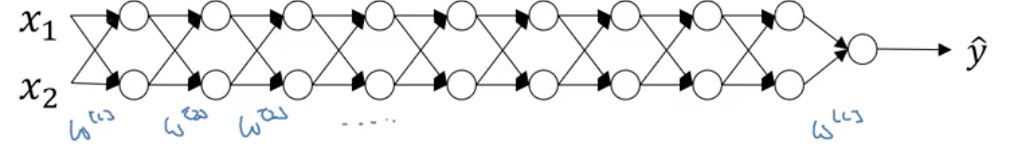
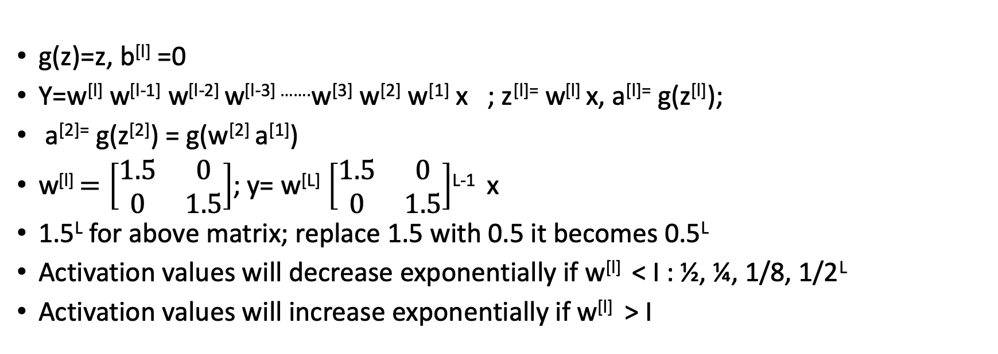
Vanishing/Exploring Gradients
g(z)=z, b^{[l]} =0
Y=w^{[l]} w^{[l-1]} w^{[l-2]} w^{[l-3] …….}w^{[3]} w^{[2]} w^{[1]} x ; z^{[l]=} w^{[l]} x, a^{[l]=} g(z^{[l]});
a^{[2]=} g(z^{[2]}) = g(w^{[2]} a^{[1]})
w^{[l]} $=\left[\begin{matrix}1.5 & 0 \\ 0 & 1.5\end{matrix}\right]$; y= w^{[L]} $\left[\begin{matrix}1.5 & 0 \\ 0 & 1.5\end{matrix}\right]$^{L-1} x
1.5^{L} for above matrix; replace 1.5 with 0.5 it becomes 0.5^{L}
Activation values will decrease exponentially if w^{[l]} < I : ½, ¼, 1/8, 1/2^{L}
Activation values will increase exponentially if w^{[l]} > I

Slide 4
Weight Initialization for Deep Networks
Z=w₁x₁+ w₂x₂ + w₃x₃ + w₄x₄ +…..+ w_{n}x_{n} +b
Large n -> smaller w_{i} ; n is number of input features
Var(w)=2/n
W^{[l]} =np.random.randn(shape)*np.sqrt(2/n^{[l-1]} ); with Relu
Xavier initialization: with tanh use np.sqrt(1/n^{[l-1]} );
Some use this as well: np.sqrt(2/(n^{[l-1]} + n^{[l]} ));

Slide 5
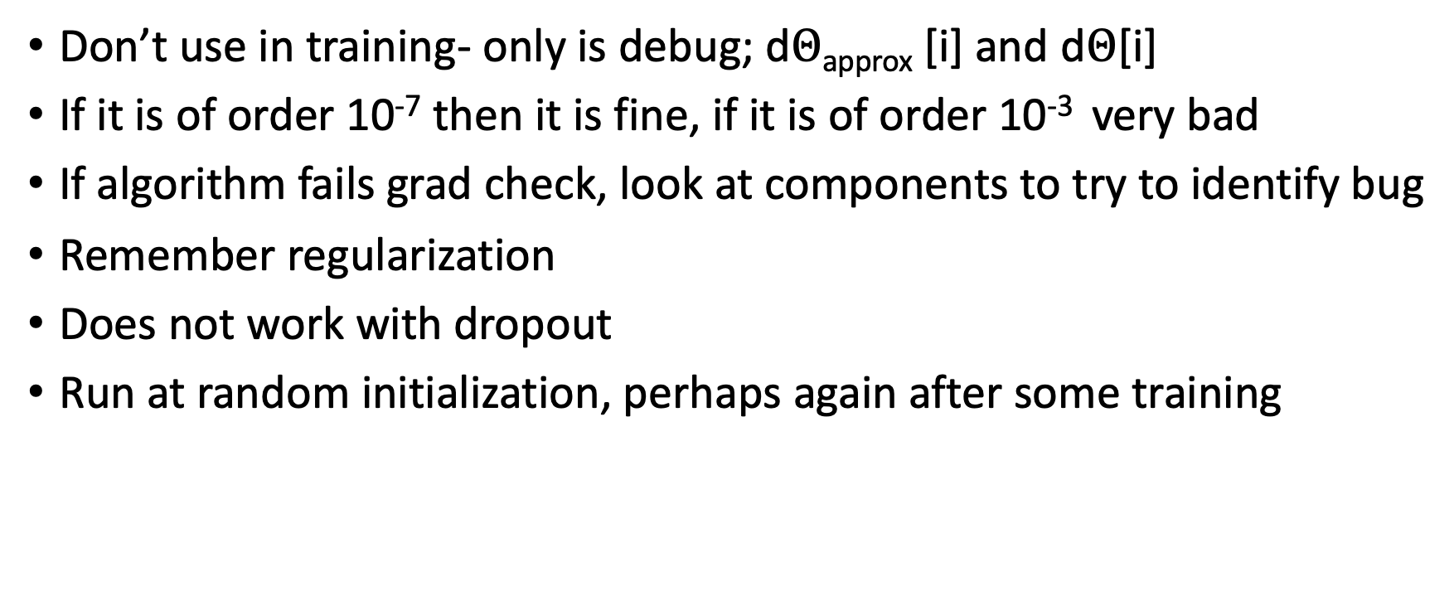
Gradient Checking
Don’t use in training- only is debug; d$Θ$_{approx} [i] and d$Θ$[i]
If it is of order 10⁻⁷ then it is fine, if it is of order 10⁻³ very bad
If algorithm fails grad check, look at components to try to identify bug
Remember regularization
Does not work with dropout
Run at random initialization, perhaps again after some training

Slide 6
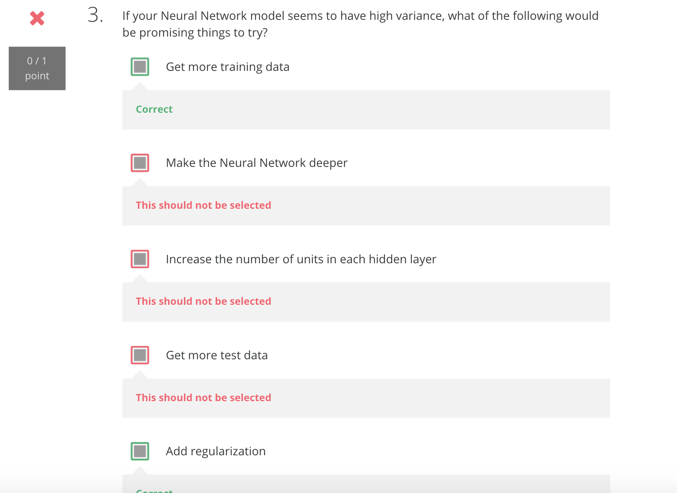
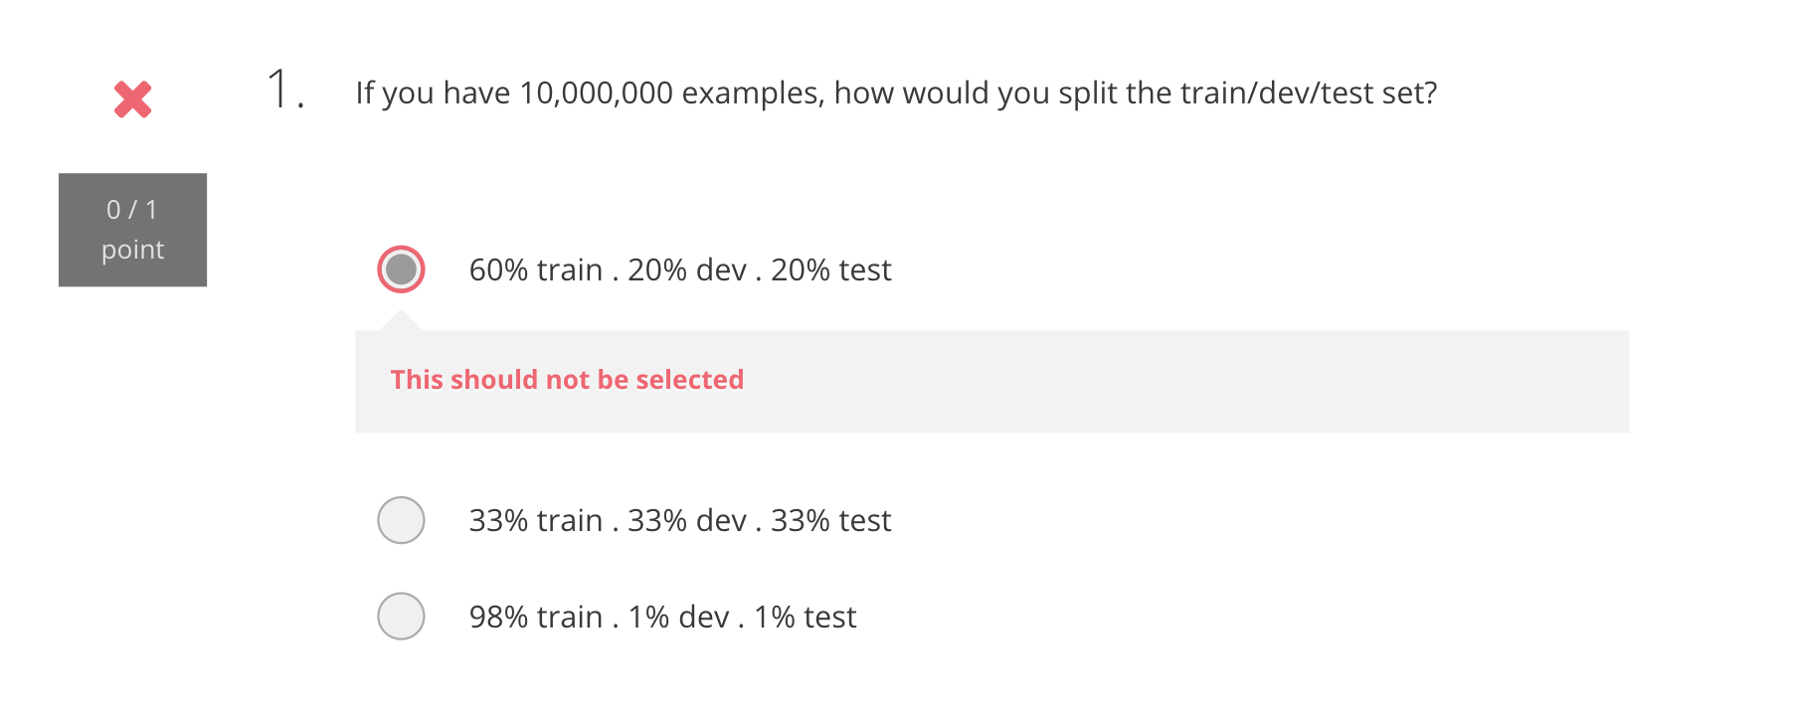
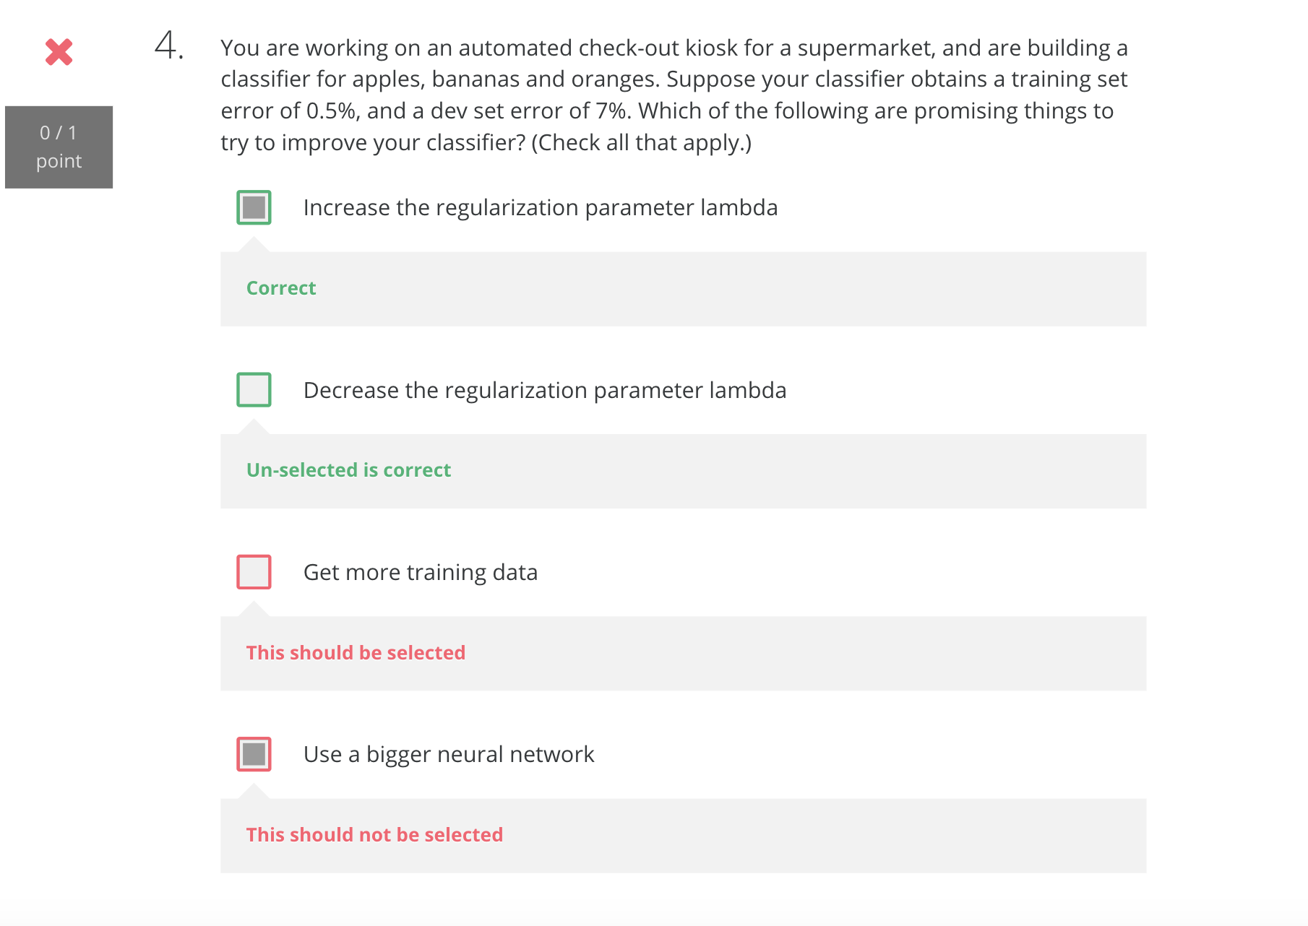
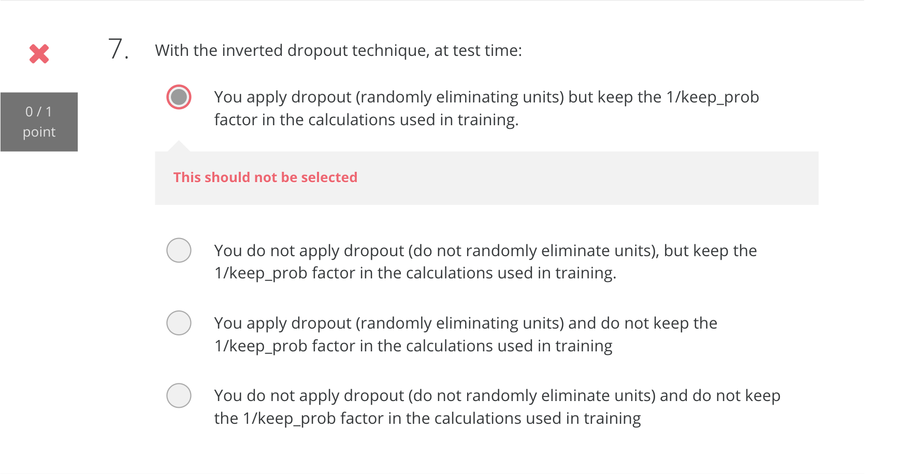
Quiz

Slide 7
Weight Initialization and L2 Regularization
The weights W[l] should be initialized randomly to break symmetry.
It is however okay to initialize the biases b[l] to zeros. Symmetry is still broken so long as W[l] is initialized randomly.
Initializing weights to very large random values does not work well.
initializing with small random values does better.
L2 regularization makes your decision boundary smoother. If λ is too large, it is also possible to "oversmooth", resulting in a model with high bias.
the implications of L2-regularization on:
The cost computation: A regularization term is added to the cost
The backpropagation function: There are extra terms in the gradients with respect to weight matrices
Weights end up smaller ("weight decay"):Weights are pushed to smaller values.

Slide 8
Dropout
Dropout is a regularization technique.
You only use dropout during training.
Don't use dropout (randomly eliminate nodes) during test time.
Apply dropout both during forward and backward propagation.
During training time, divide each dropout layer by keep_prob to keep the same expected value for the activations. For example, if keep_prob is 0.5, then we will on average shut down half the nodes, so the output will be scaled by 0.5 since only the remaining half are contributing to the solution. Dividing by 0.5 is equivalent to multiplying by 2. Hence, the output now has the same expected value. You can check that this works even when keep_prob is other values than 0.5.

Slide 9
OPTIMIZATION ALGORITHMS

Slide 10
Mini Batch Gradient Descent
Vectorization allows to compute on m examples
X (n_{x},m)=[x^{[1]} , x^{[2]} , x^{[3]} ……………. x^{[m]} ]
Y (1,m)= [y^{[1]} , y^{[2]} , y^{[3]} ……………. y^{[m]} ]
What if m =5,000,000? Split into 5000 minibatches of 1000 each
X^{{1}} =[x^{[1]} , x^{[2]} , x^{[3]} … x^{[1000]} ], X^{{2}} =[x^{[1001]} , x^{[1002]} …… x^{[2000]} ]
Y^{{1}} =[y^{[1]} , y^{[2]} , y^{[3]} ……… y^{[1000]} ], Y^{{2}} =[y^{[1001]} , y^{[1002]} …… y^{[2000]} ]
Minibatch t: X^{{t}} (n_{x} ,1000) , Y^{{t}} (1,1000)

Slide 11
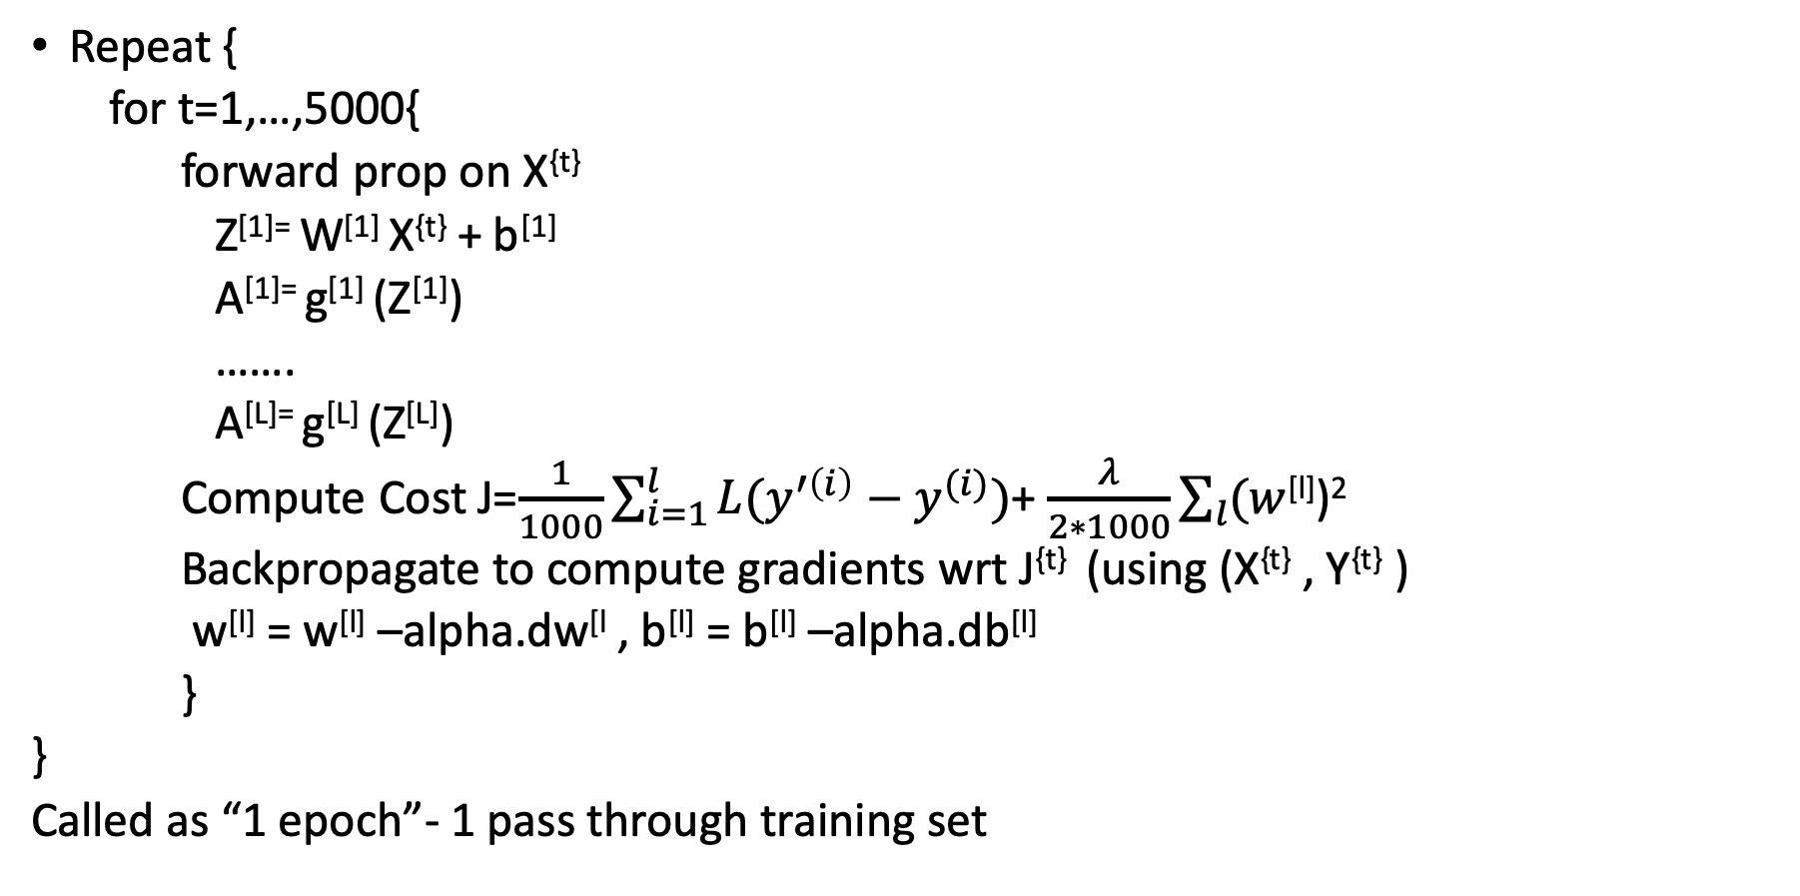
Mini Batch Gradient Descent
Repeat {
for t=1,…,5000{
forward prop on X^{{t}}
Z^{[1]=} W^{[1]} X^{{t}} + b^{[1]}
A^{[1]=} g^{[1]} (Z^{[1]})
…….
A^{[L]=} g^{[L]} (Z^{[L]})
Compute Cost J=$\frac{1}{1000}\sum_{i=1}^{l}{L(y^{′\left(i\right)}−y^{(i)})}$+ $\frac{λ}{2∗1000}\sum_{l}{(w}$^{[l]})²
Backpropagate to compute gradients wrt J^{{t}} (using (X^{{t}} , Y^{{t}} )
w^{[l]} = w^{[l]} –alpha.dw^{[l} , b^{[l]} = b^{[l]} –alpha.db^{[l]}
}
}
Called as “1 epoch”- 1 pass through training set
Vectorized implementation (1000 examples)

Slide 12
Choosing our mini-batch size
If minibatch size=m: batch gradient descent. (X^{{1}} ,Y^{{1}})=(X,Y), takes too much time for large m, can be used for small training set (m<=2000)
If minibatch size=1: stochastic gradient descent. Every example is it’s own mini batch. (X^{{1}} ,Y^{{1}})=(X ^{[1]},Y ^{[1]}). Can be extremely noisy, its always oscillating, never converging. Loose all speed from vectorization
In practice: somewhere between 1 and m (not too big/small), gives fastest learning. Make progress without processing entire training set. Take power of two: 64, 128, 256, 512, 1024

Slide 13
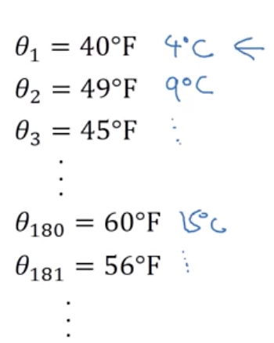
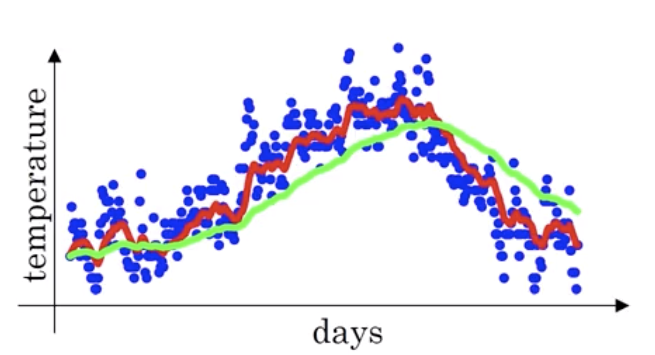
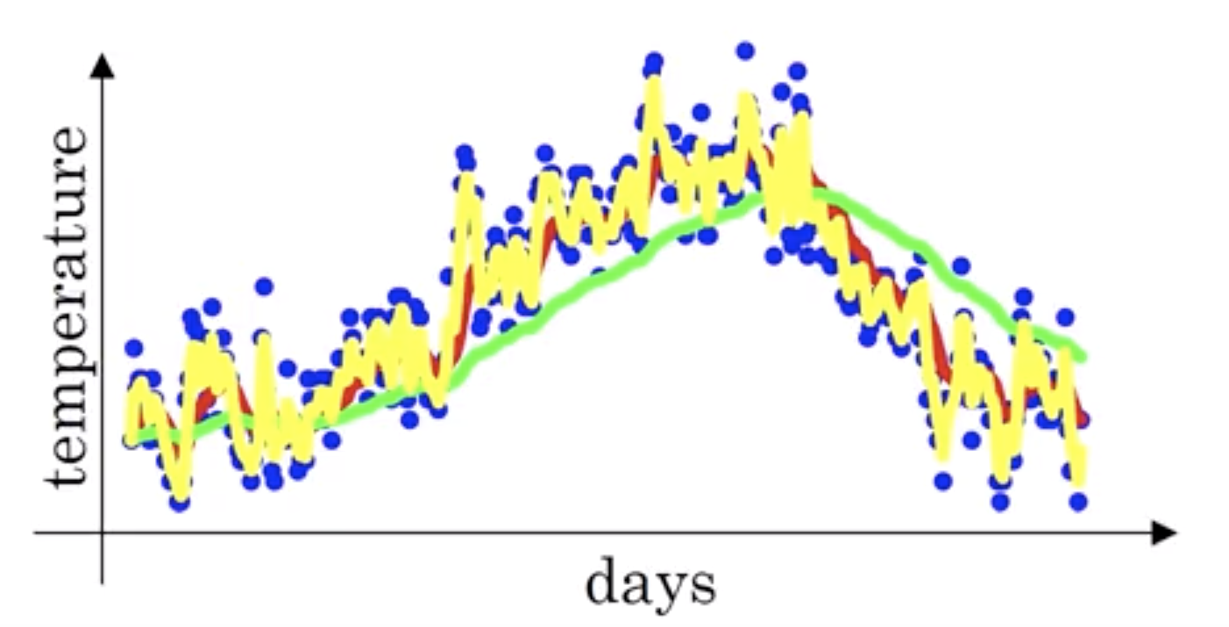
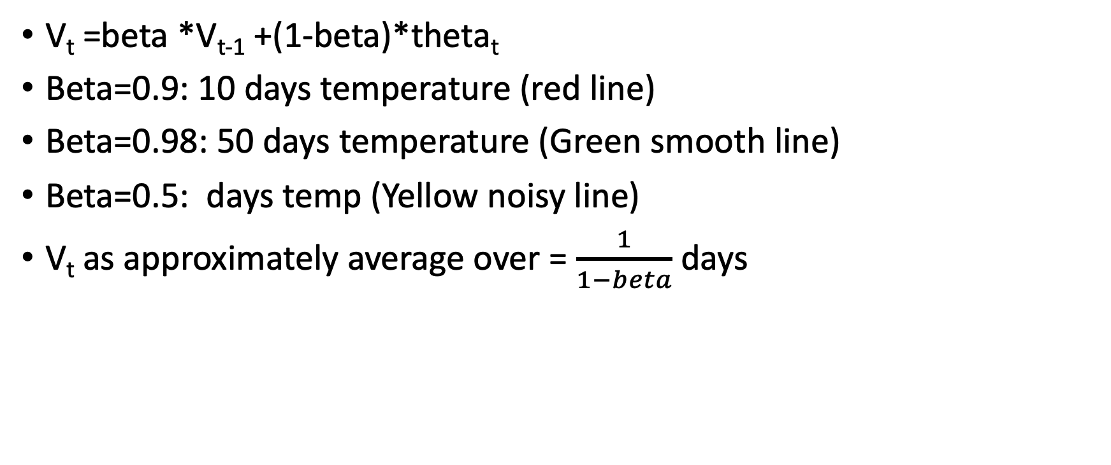
Exponential Weighted Moving Averages
V_{t} =beta *V_{t-1} +(1-beta)*theta_{t}
Beta=0.9: 10 days temperature (red line)
Beta=0.98: 50 days temperature (Green smooth line)
Beta=0.5: days temp (Yellow noisy line)
V_{t} as approximately average over = $\frac{1}{1−beta}$ days

Slide 14
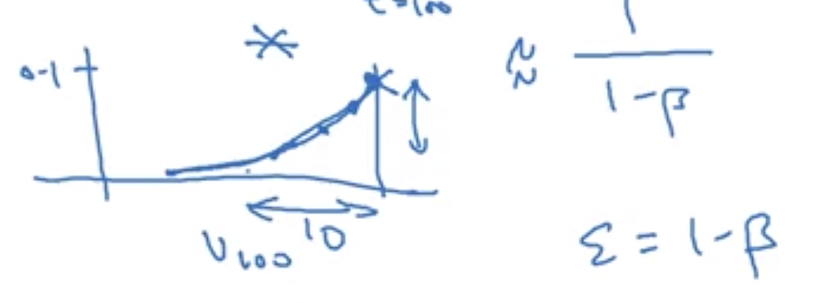
Exponential Weighted Moving Averages
V_{t} =beta *V_{t-1} +(1-beta)*theta_{t}
V₁₀₀ =0.9 *V₉₉ +0.1*theta₁₀₀
V₉₉ =0.9 *V₉₈ +0.1*theta₉₉
V₉₈ =0.9 *V₉₇ +0.1*theta₉₈
V₁₀₀ =0.1*theta₁₀₀ + 0.9 *(0.1*theta₉₉ + 0.9 *(0.9 *V₉₇ +0.1*theta₉₈))
0.9¹⁰ =0.35=1/e ; 0.98⁵⁰ =1/e

Slide 15
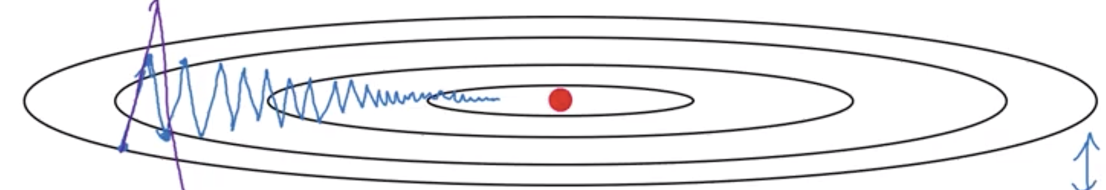
Gradient Descent with momentum
On Vertical axis, we want slower learning rate
On horizontal axis, we want faster learning rate
On iteration t:
Compute dw,db on current minibatch
V_{dw} =beta. V_{dw} +(1-beta).dw
V_{db} =beta. V_{db} +(1-beta).db
w=w-alpha. V_{dw} , b=b-alpha. V_{db}
Hyperparameters: alpha, beta; beta=0.9

Slide 16
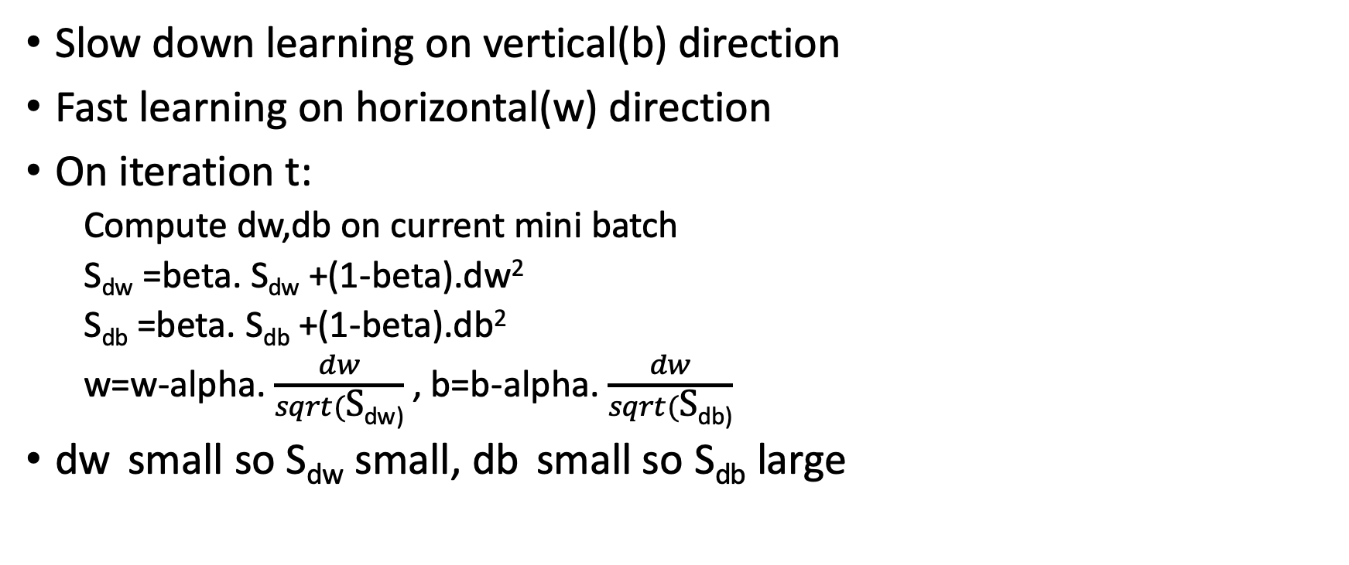
Root Mean Square Prop
Slow down learning on vertical(b) direction
Fast learning on horizontal(w) direction
On iteration t:
Compute dw,db on current mini batch
S_{dw} =beta. S_{dw} +(1-beta).dw²
S_{db} =beta. S_{db} +(1-beta).db²
w=w-alpha. $\frac{dw}{sqrt(\text{S}\text{dw}\text{)}}$ , b=b-alpha. $\frac{dw}{sqrt(\text{S}\text{d}\text{b}\text{)}}$
dw small so S_{dw} small, db small so S_{db} large

Slide 17
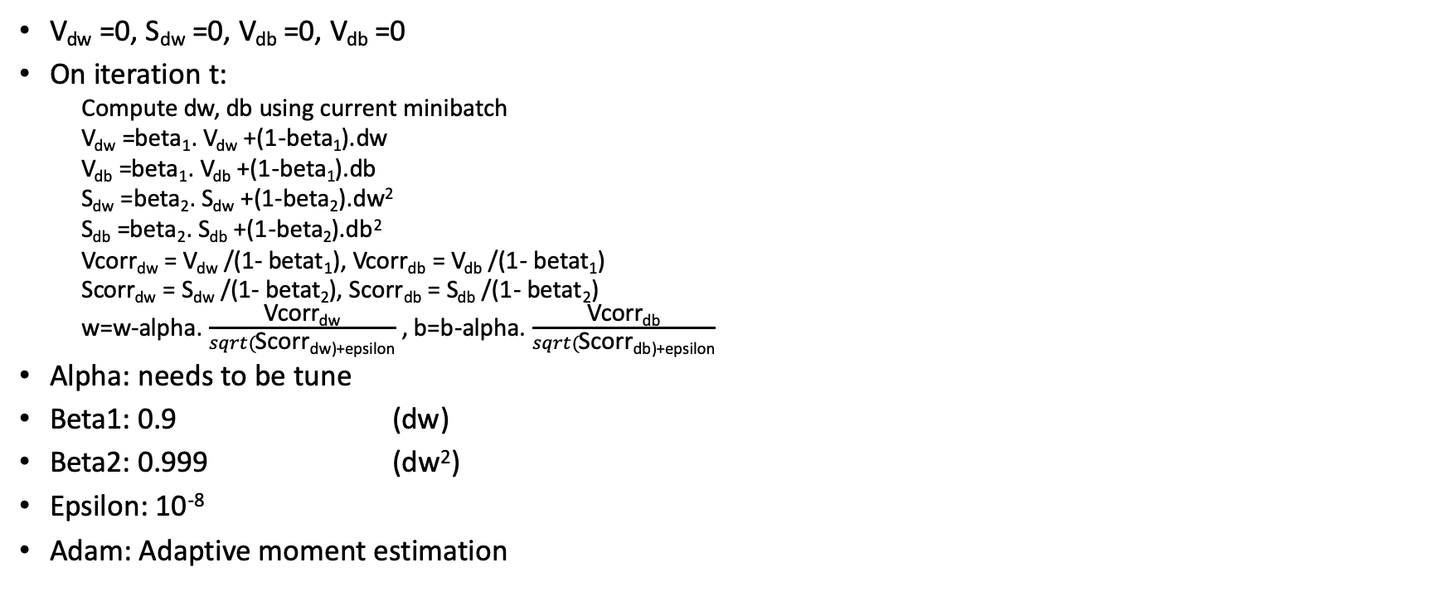
Adam Optimization Algorithm
V_{dw} =0, S_{dw} =0, V_{db} =0, V_{db} =0
On iteration t:
Compute dw, db using current minibatch
V_{dw} =beta₁. V_{dw} +(1-beta₁).dw
V_{db} =beta₁. V_{db} +(1-beta₁).db
S_{dw} =beta₂. S_{dw} +(1-beta₂).dw²
S_{db} =beta₂. S_{db} +(1-beta₂).db²
Vcorr_{dw} = V_{dw} /(1- betat₁), Vcorr_{db} = V_{db} /(1- betat₁)
Scorr_{dw} = S_{dw} /(1- betat₂), Scorr_{db} = S_{db} /(1- betat₂)
w=w-alpha. $\frac{\text{Vcorr}\text{dw}}{sqrt(\text{Scorr}\text{dw}\text{)+}\text{epsilon}}$ , b=b-alpha. $\frac{\text{Vcorr}\text{db}}{sqrt(\text{Scorr}\text{db}\text{)+}\text{epsilon}}$
Alpha: needs to be tune
Beta1: 0.9 (dw)
Beta2: 0.999 (dw²)
Epsilon: 10⁻⁸
Adam: Adaptive moment estimation

Slide 18
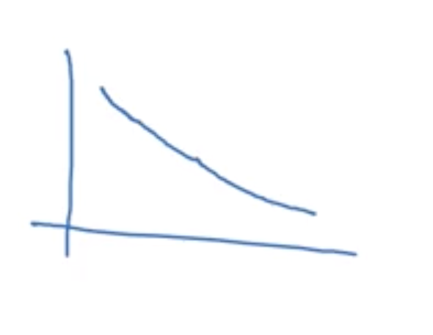
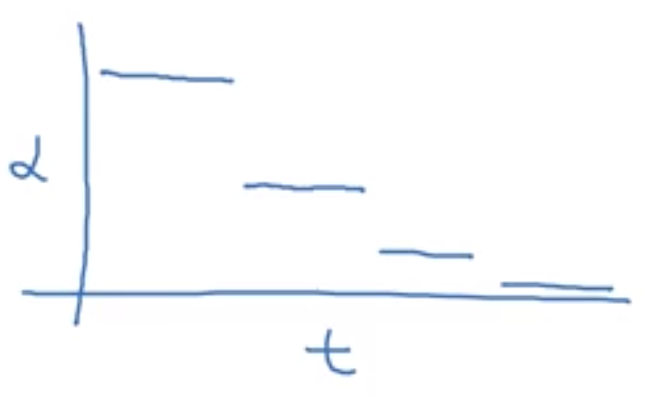
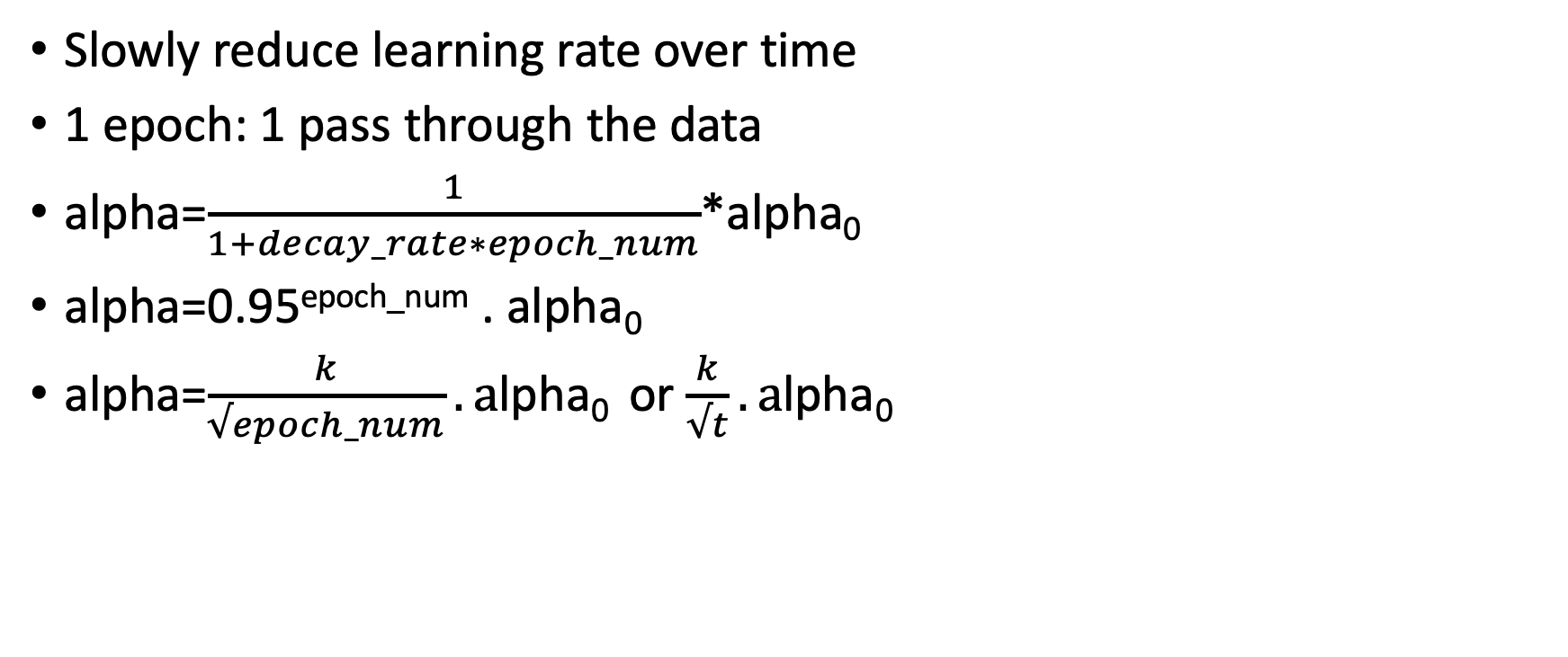
Learning Rate Decay
E_{poch} | alpha
1 | 0.1
2 | 0.67
3 | 0.5
4 | 0.4
Slowly reduce learning rate over time
1 epoch: 1 pass through the data
alpha=$\frac{1}{1+decay_rate∗epoch_num}$*alpha₀
alpha=0.95^{epoch_num} . alpha₀
alpha=$\frac{k}{√epoch_num}. a$lpha₀ or $\frac{k}{√t}. a$lpha₀

Slide 19
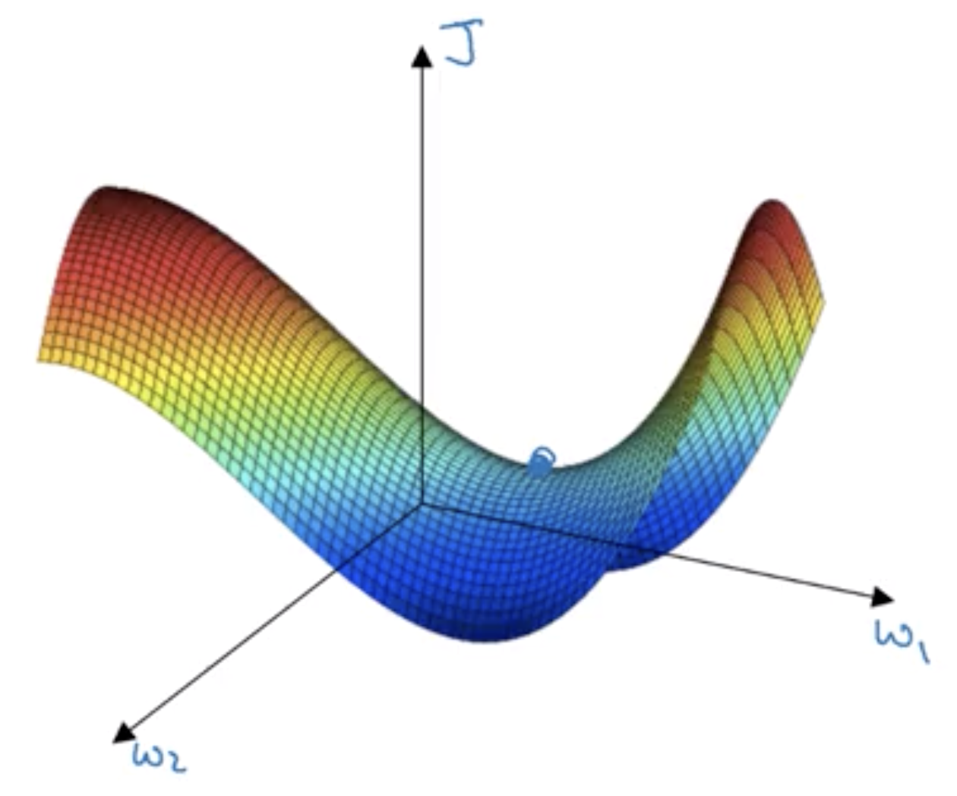
Problem of Local Optima
Saddle point: where derivative is zero
Problem of Plateaus:
Unlikely to get stuck in a bad local optima
Plateaus can make learning slow

Slide 20
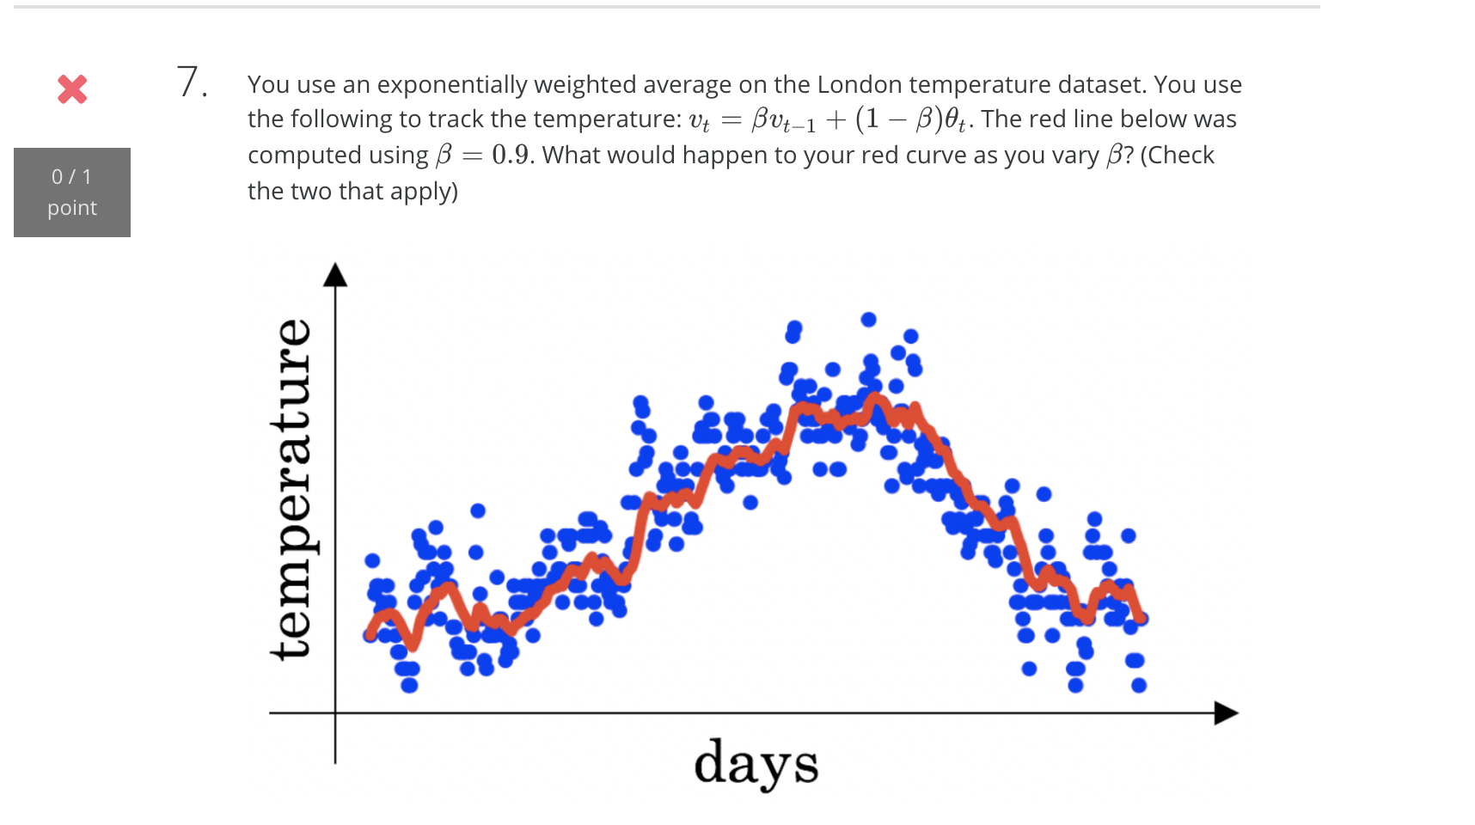
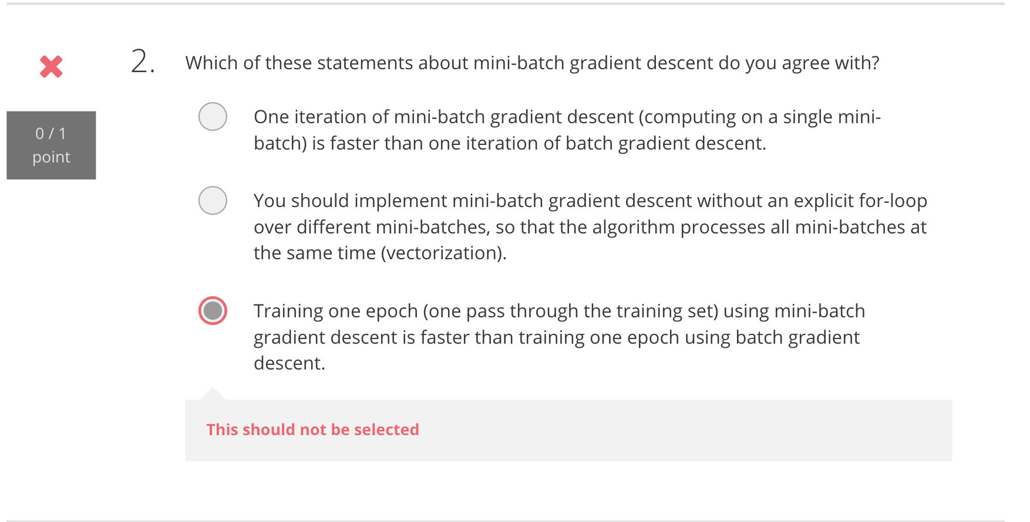
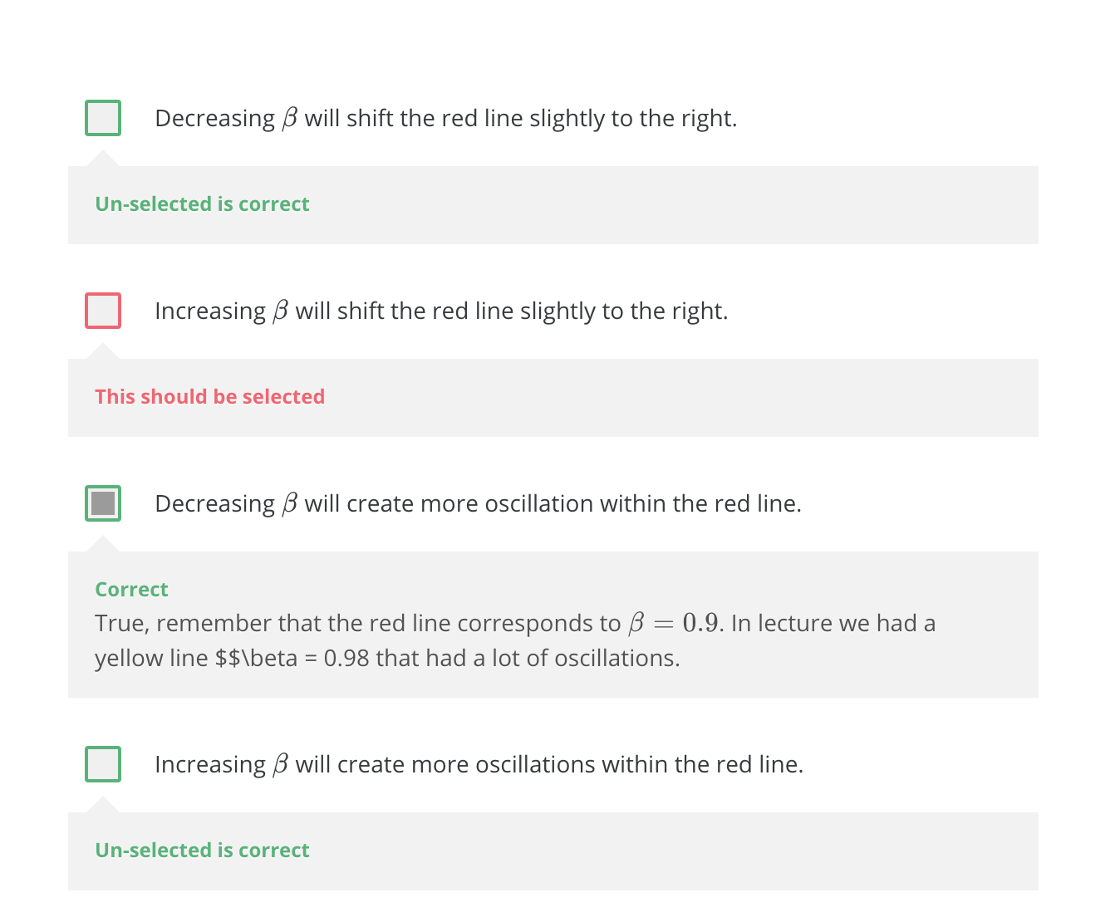
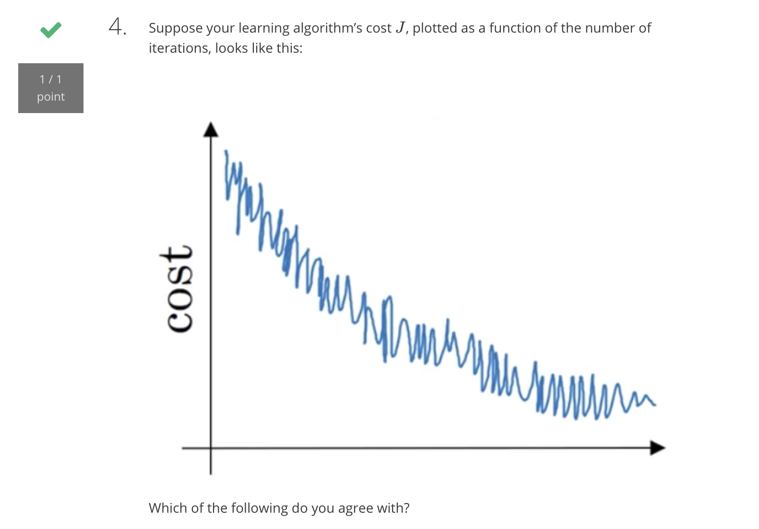
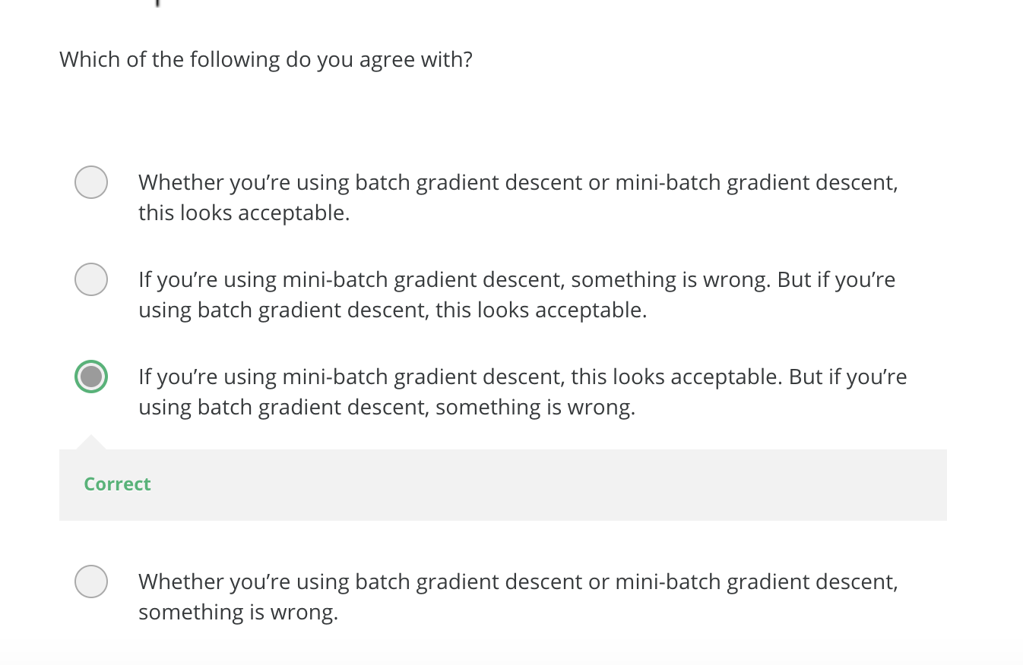
Quiz-optimization

Slide 21
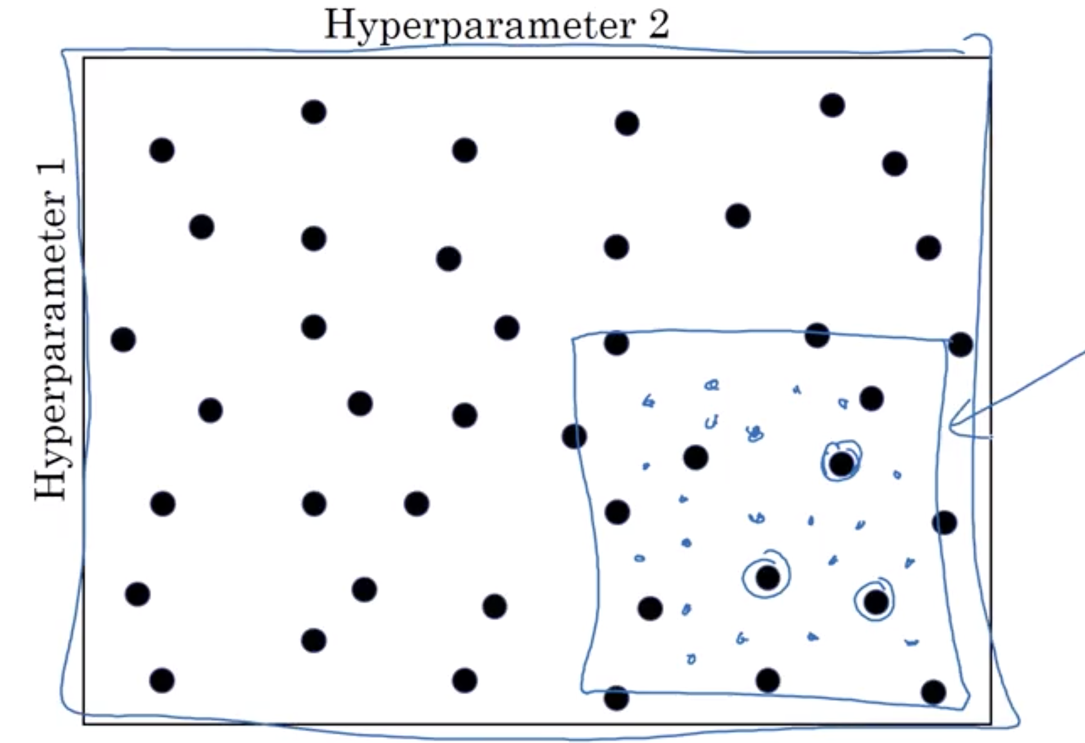
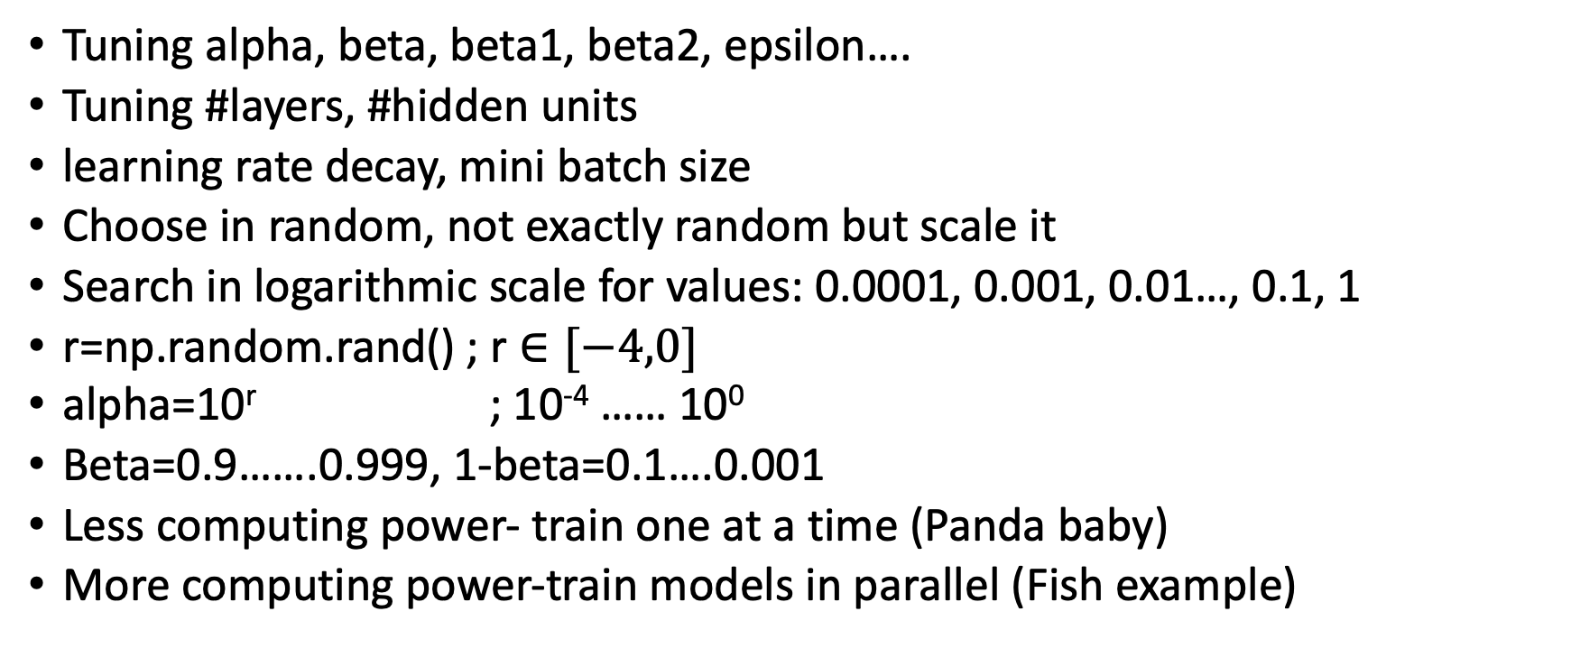
Hyperparameter Tuning
Tuning alpha, beta, beta1, beta2, epsilon….
Tuning #layers, #hidden units
learning rate decay, mini batch size
Choose in random, not exactly random but scale it
Search in logarithmic scale for values: 0.0001, 0.001, 0.01…, 0.1, 1
r=np.random.rand() ; r$∈[−4,0]$
alpha=10^{r} ; 10⁻⁴ …… 10⁰
Beta=0.9…….0.999, 1-beta=0.1….0.001
Less computing power- train one at a time (Panda baby)
More computing power-train models in parallel (Fish example)

Slide 22
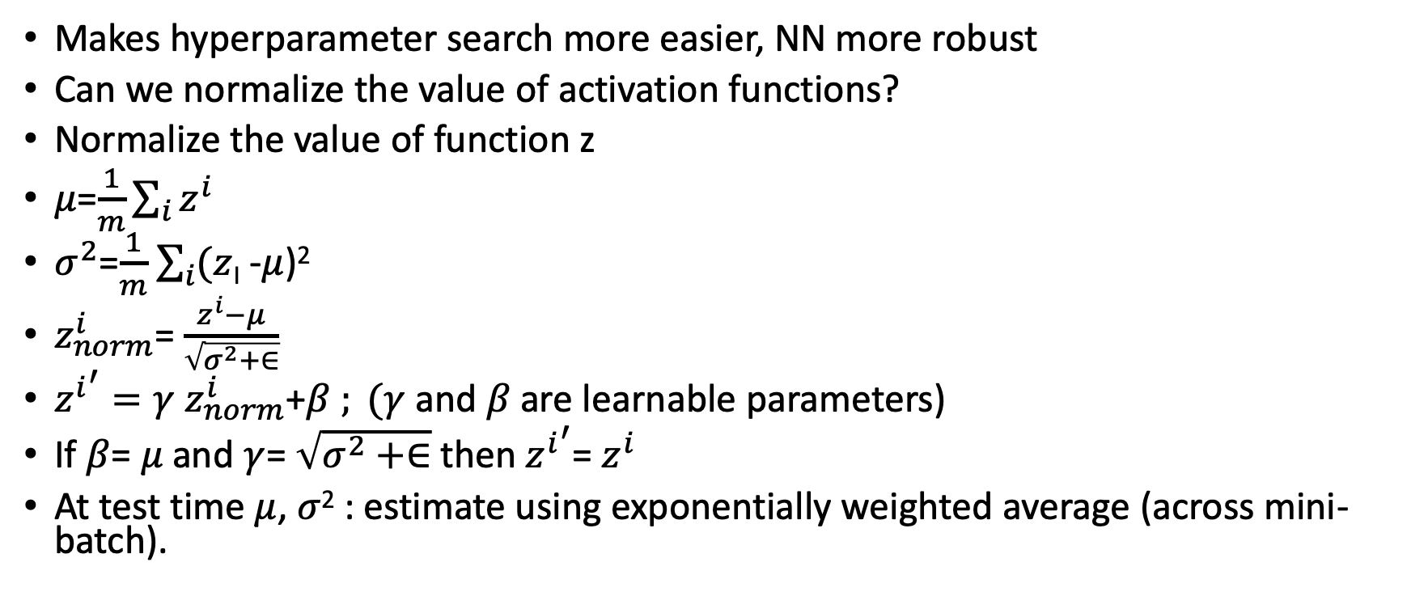
Batch Normalization
Makes hyperparameter search more easier, NN more robust
Can we normalize the value of activation functions?
Normalize the value of function z
$μ$=$\frac{1}{m}\sum_{i}{z^{i}}$
$σ^{2}$=$\frac{1}{m}$ $\sum_{i}{(z}$_{I} -$μ$)²
$z_{norm}^{i}$= $\frac{z^{i}−μ}{\sqrt{σ^{2}+∈}}$
${z^{i}}^{′}=γ$ $z_{norm}^{i}$+$β$ $; (γ$ and $β$ are learnable parameters)
If $β$= $μ$ and $γ$= $\sqrt{σ^{2}+∈}$ then ${z^{i}}^{′}$= $z^{i}$
At test time $μ$, $σ$² : estimate using exponentially weighted average (across mini-batch).

Slide 23
Batch Normalization as Regularization
If distribution of x changes then we need to retrain model
Covariance shift
Each mini-shift is scaled by the mean/variance computed on just hat mini-batch
This adds some noise to the values z^{[l]} within that minibatch. So, similar to dropout it adds some noise to each hidden layer’s activations.
This has a slight regularization effect.

Slide 24
Multi-class classification

Slide 25
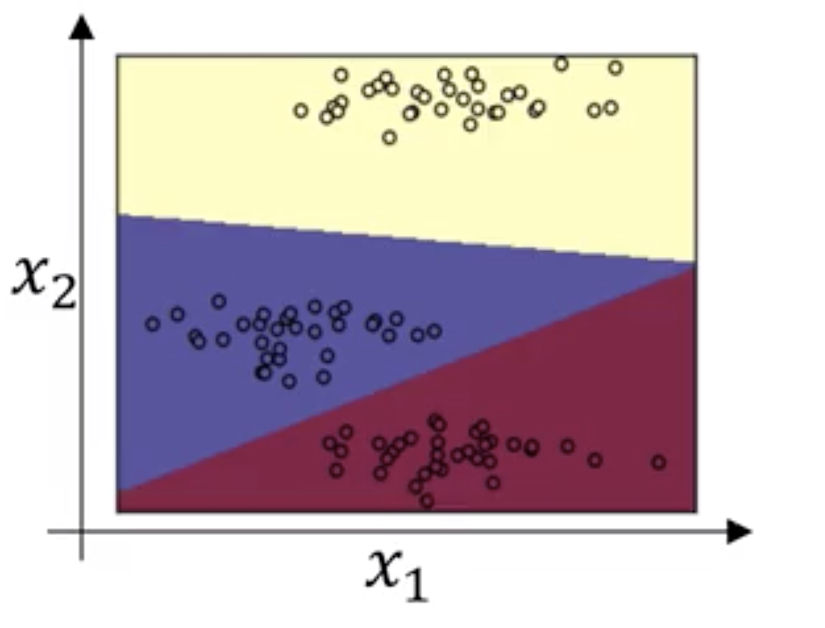
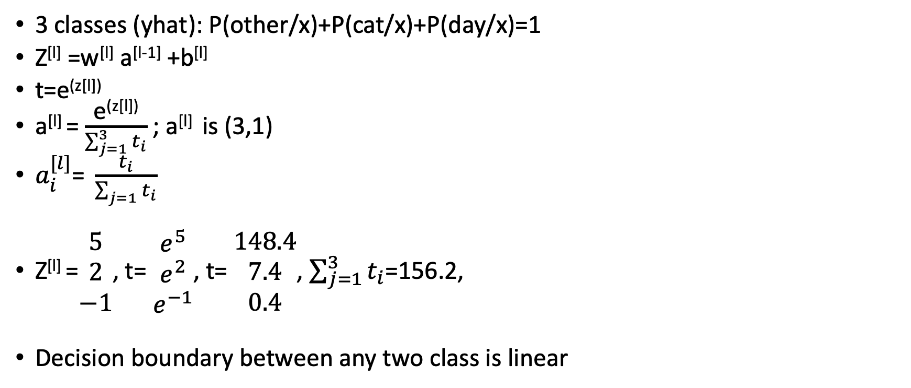
Softmax Regression
3 classes (yhat): P(other/x)+P(cat/x)+P(day/x)=1
Z^{[l]} =w^{[l]} a^{[l-1]} +b^{[l]}
t=e^{(z[l])}
a^{[l]} = $\frac{\text{e}\text{(}\text{z}\text{[}\text{l}\text{])}}{\sum_{j=1}^{3}{t_{i}}}$ ; a^{[l]} is (3,1)
$a_{i}^{[l]}$= $\frac{t_{i}}{\sum_{j=1}{t_{i}}}$
Z^{[l]} =$\begin{matrix}5 \\ 2 \\ −1\end{matrix}$, t= $\begin{matrix}e^{5} \\ e^{2} \\ e^{−1}\end{matrix}$, t= $\begin{matrix}148.4 \\ 7.4 \\ 0.4\end{matrix}$, $\sum_{j=1}^{3}{t_{i}}$=156.2,
Decision boundary between any two class is linear

Slide 26
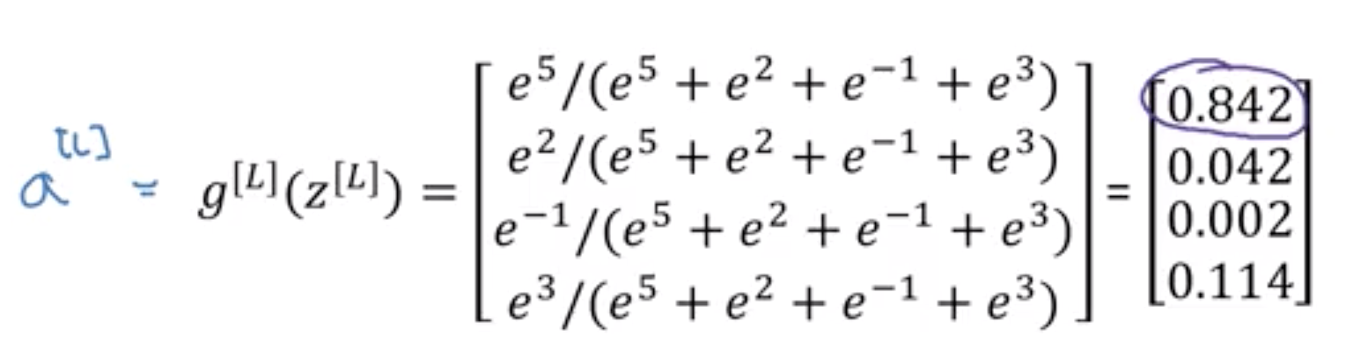
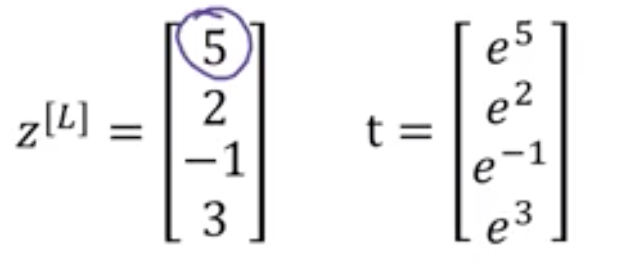
Softmax classifier
Called as softmax because it directly doesnot maps to 0 and 1 but to some probabilities
It generalizes logistic regression to c classes

Slide 27
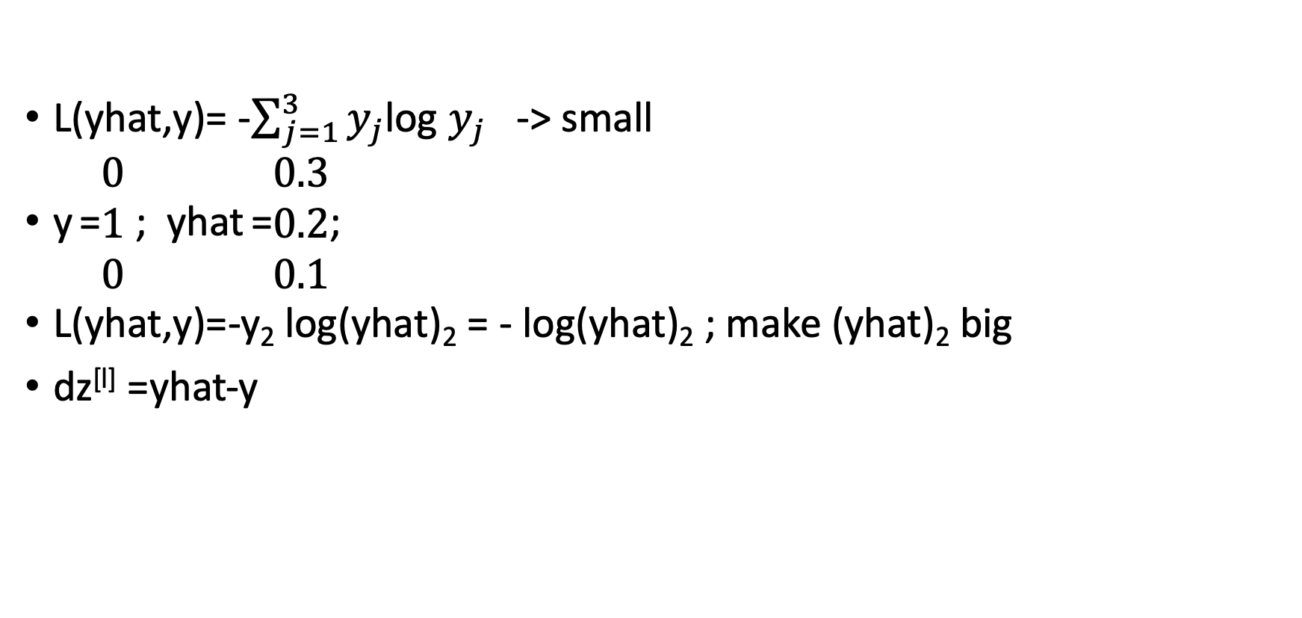
Softmax classifier: loss function
L(yhat,y)= -$\sum_{j=1}^{3}{y_{j}}$log $y_{j}$ -> small
y =$\begin{matrix}0 \\ 1 \\ 0\end{matrix}$ ; yhat =$\begin{matrix}0.3 \\ 0.2 \\ 0.1\end{matrix}$;
L(yhat,y)=-y₂ log(yhat)₂ = - log(yhat)₂ ; make (yhat)₂ big
dz^{[l]} =yhat-y

Slide 28
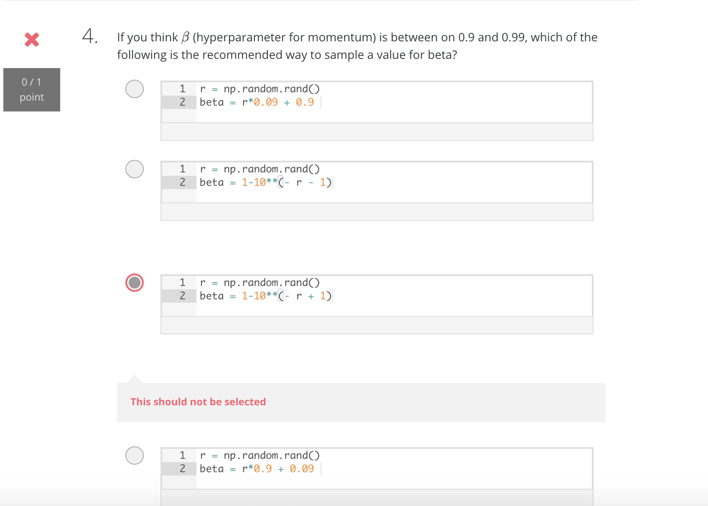
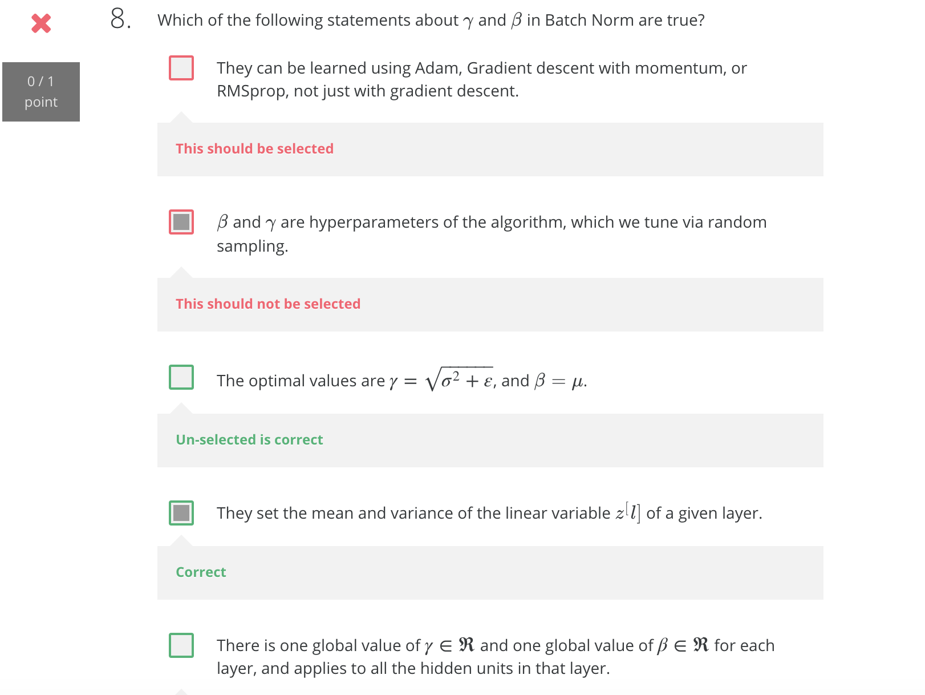
Quiz

Slide 29
Convolutions Neural Networks

Slide 30
Computer Vision Problems
Image Classifications- cat vs. non cat classification
Object Classifications- draw boundary across objects
Neural Style Transfer- merge two images

Slide 31
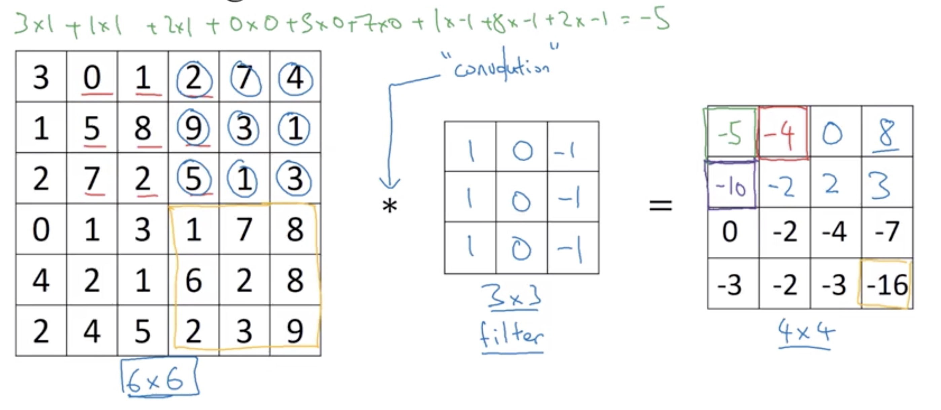
Vertical Edge detection

Slide 32
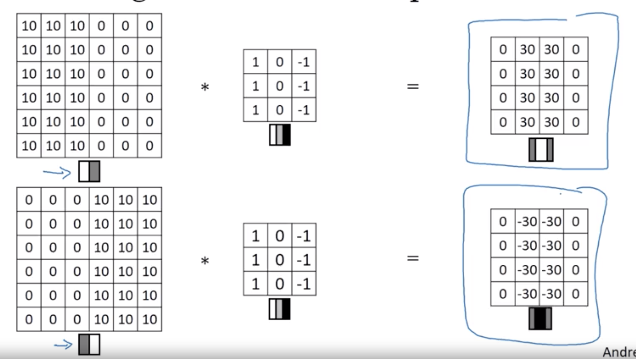
Vertical Edge Detection

Slide 33
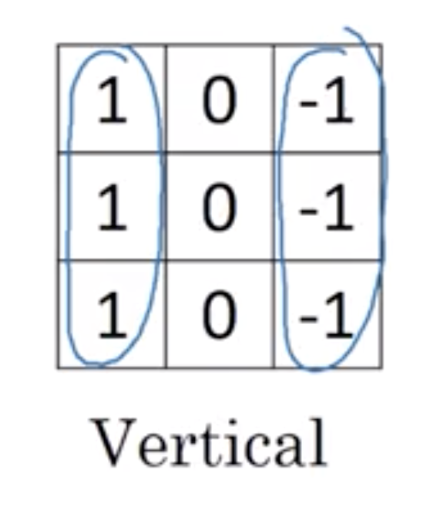
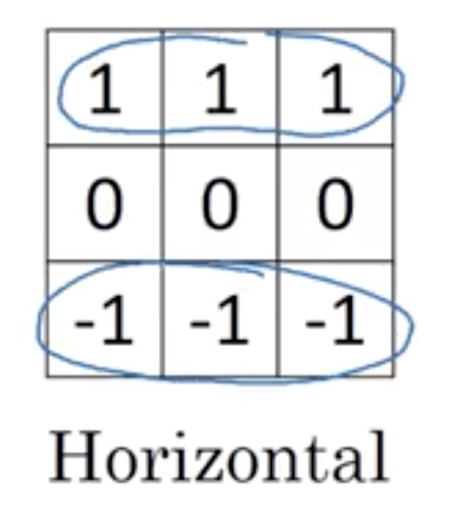
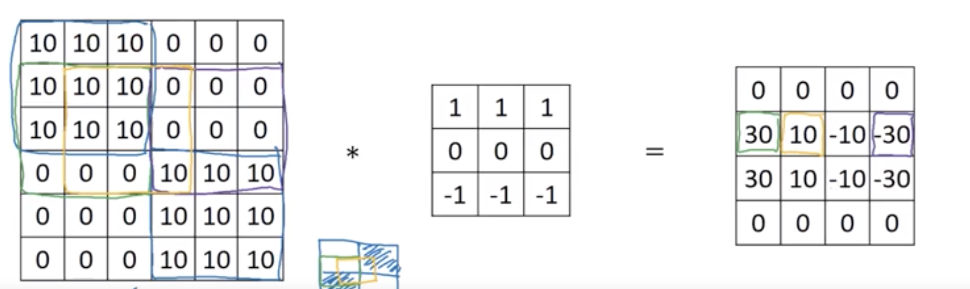
Edge Detection
Vertical- Pixels are lighter on left and darker on right
Horizontal- Pixels are lighter on top and darker on bottom

Slide 34
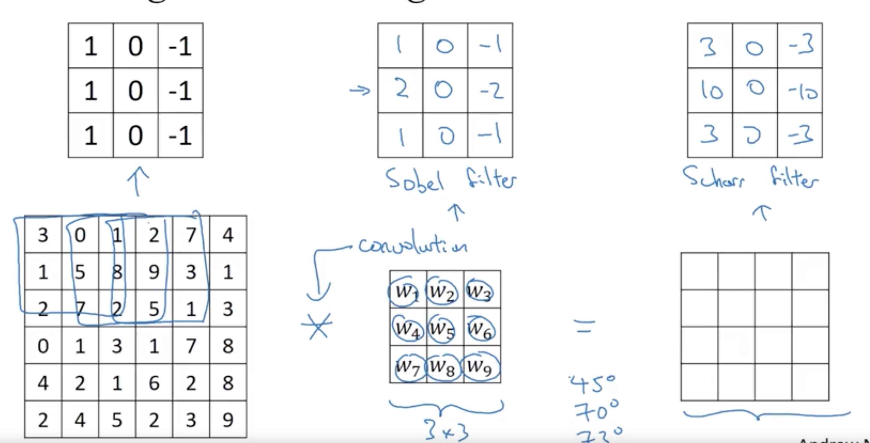
Edge Detection
If we need to detect images with some complicated numbers we don’t need to choose filter numbers, we can learn it using backpropagation

Slide 35
Padding
If the image is n*n and filter is f*f, resulting image will be (n-f)+1*(n-f)+1
Downside:
Image shrinks- don’t want images to shrink
Pixels near edges are used less than pixels in middle- throws away useful information
So we pad the border of image with p pixels (take p=1 : 6*6->8*8)
Formula: n+2p-f+1=6+2-3+1=6
Valid convolution: np padding n*n * f*f -> n-f+1 * n-f+1
Same convolution: Pad so that the output size is same as input size
n+2p-f+1=n
P=(f-1)/2; filter: 3*3, p=1; filter 5*5, p=(5-1)/2=2
By convention f is usually odd

Slide 36
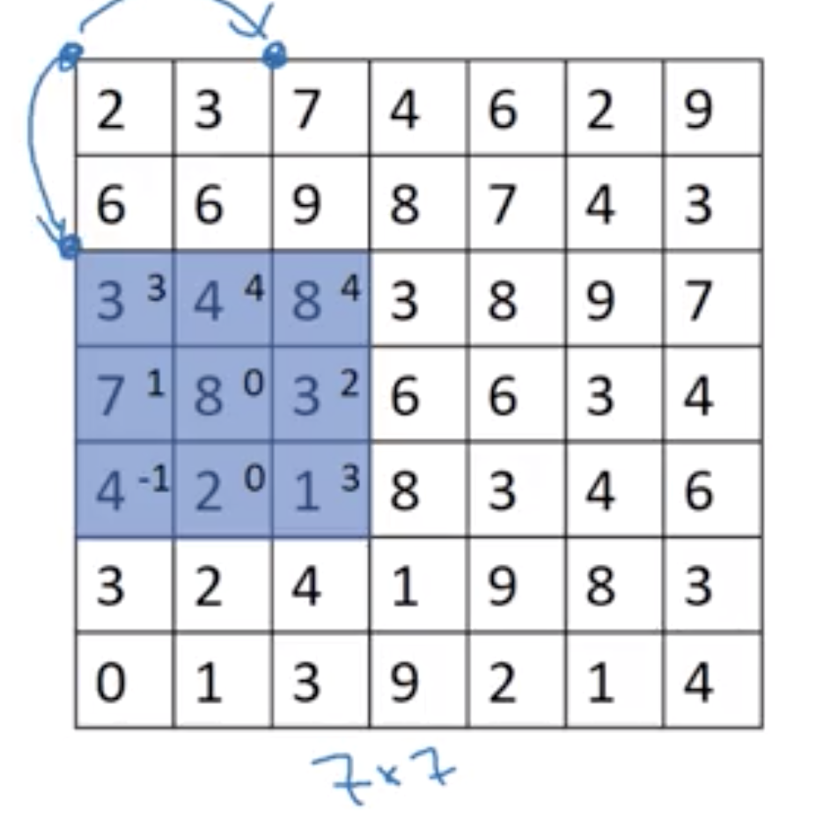
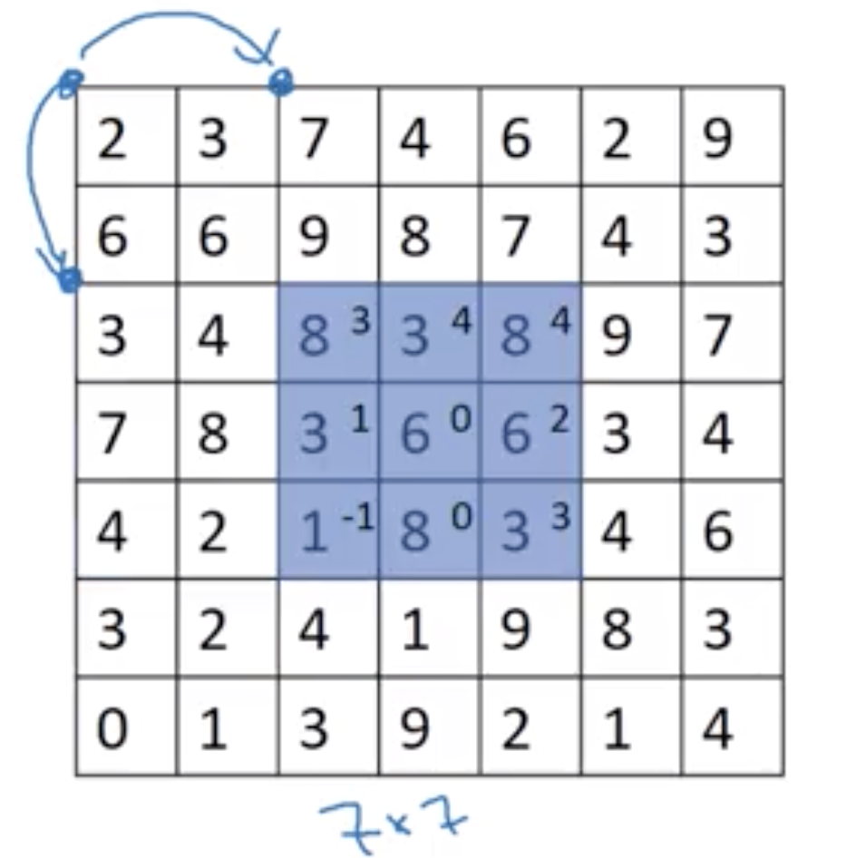
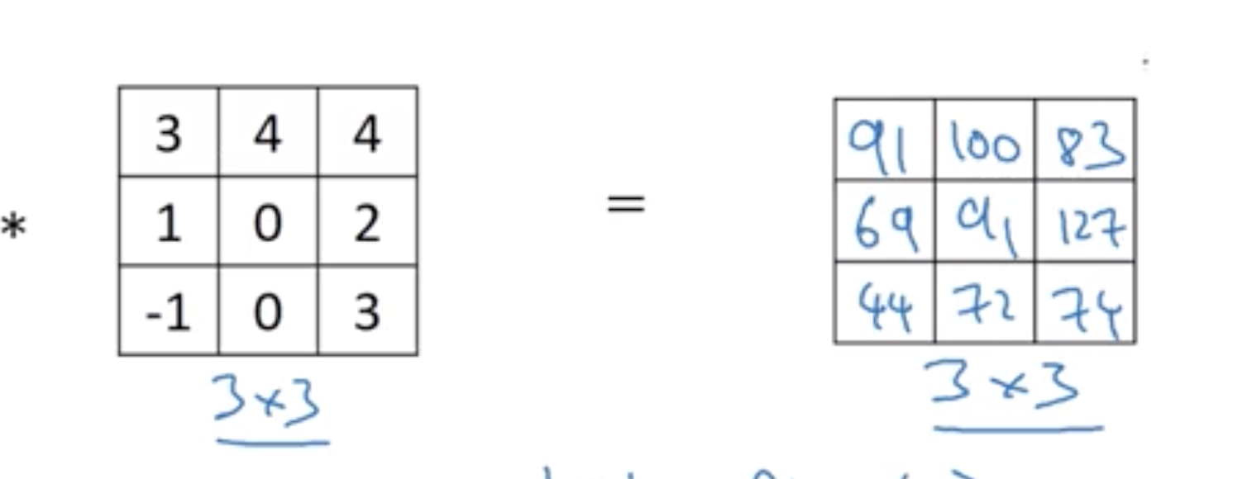
Strided Convolutions
Stride means hoping the filter over image by n steps
n*n (padding p) * f*f (stride s) => floor((n+2p-f)/s +1) * (n+2p-f)/s +1
7*7 (p=0) * 3*3 (s=2) => floor((7+0-3)/2 +1)=3

Slide 37
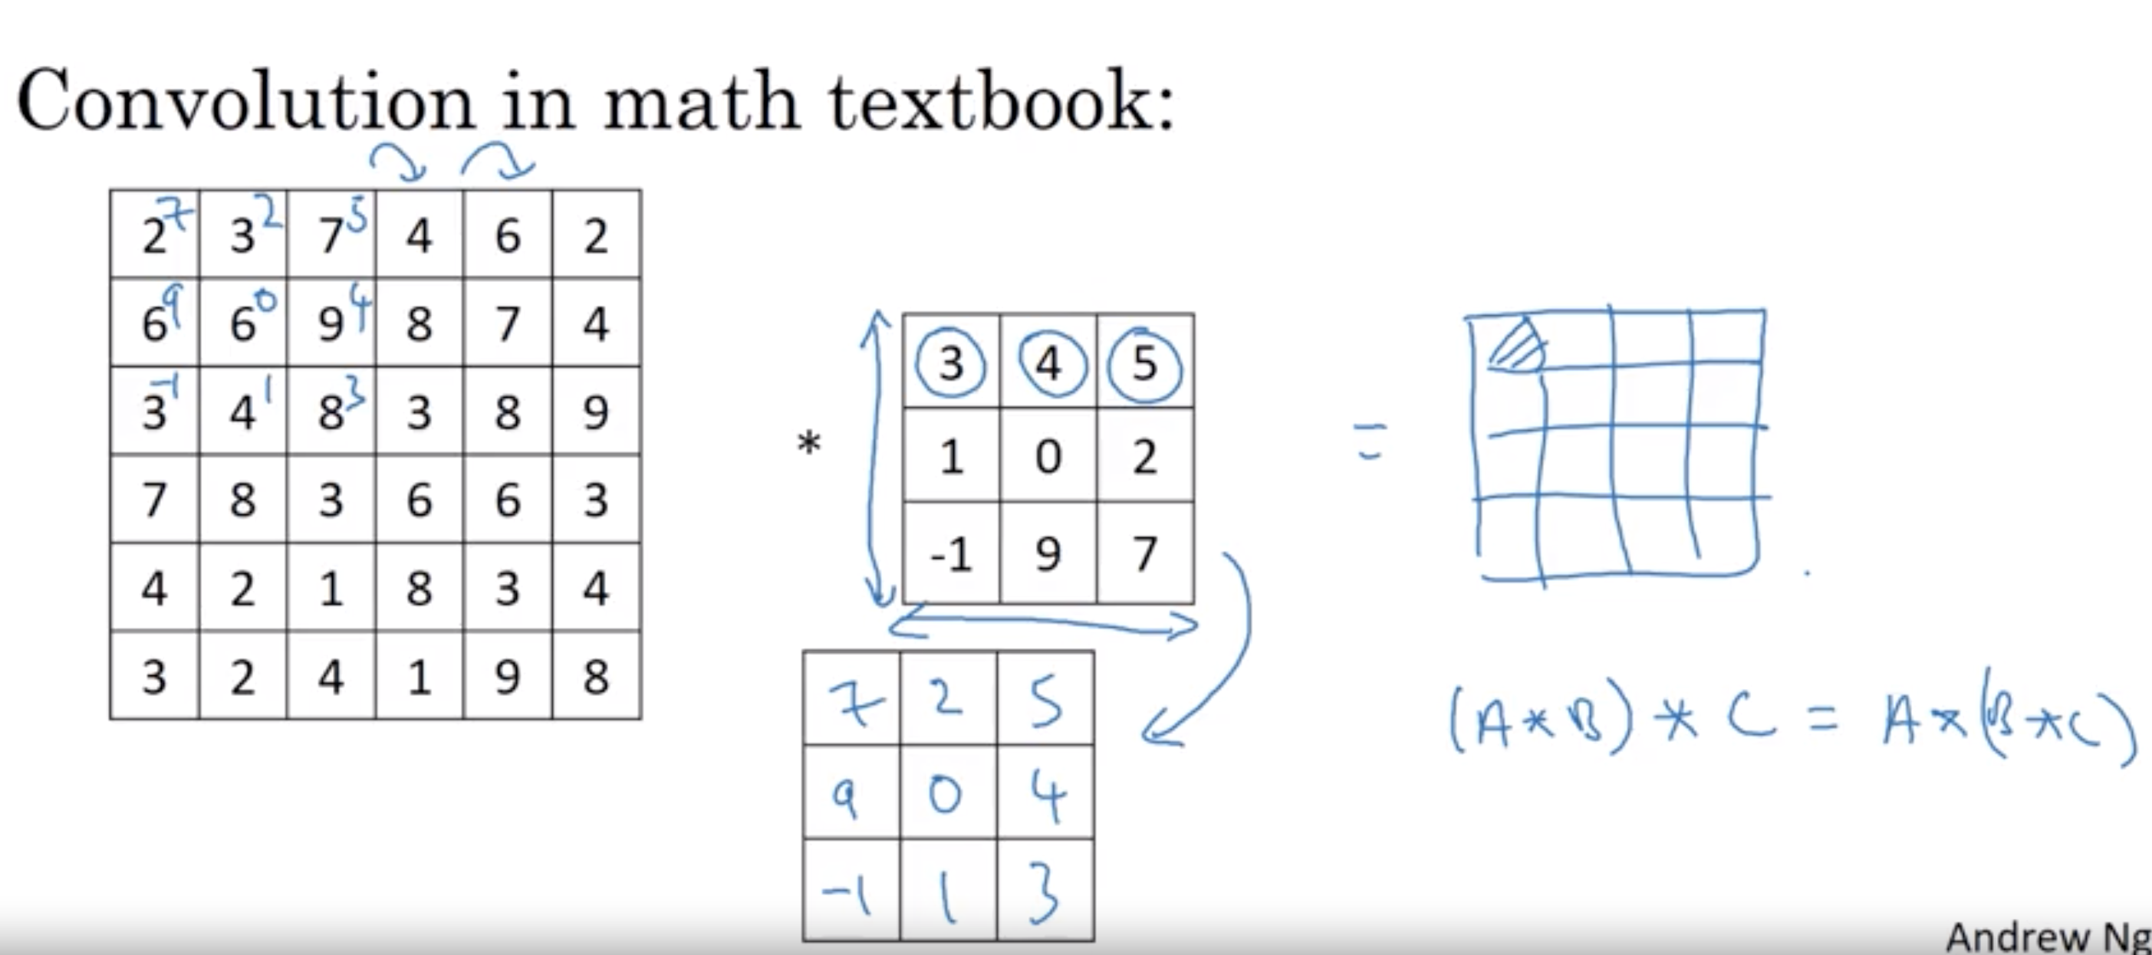
Cross correlation vs convolution

Slide 38
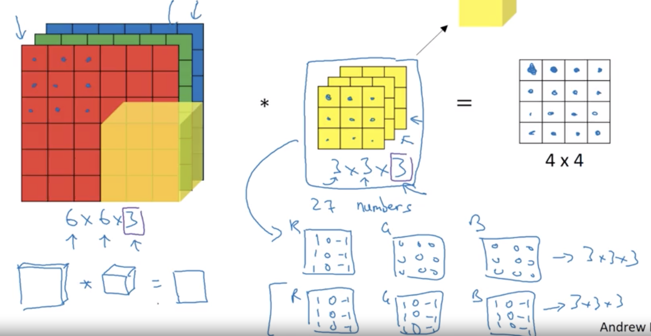
Convolutions over volumes

Slide 39
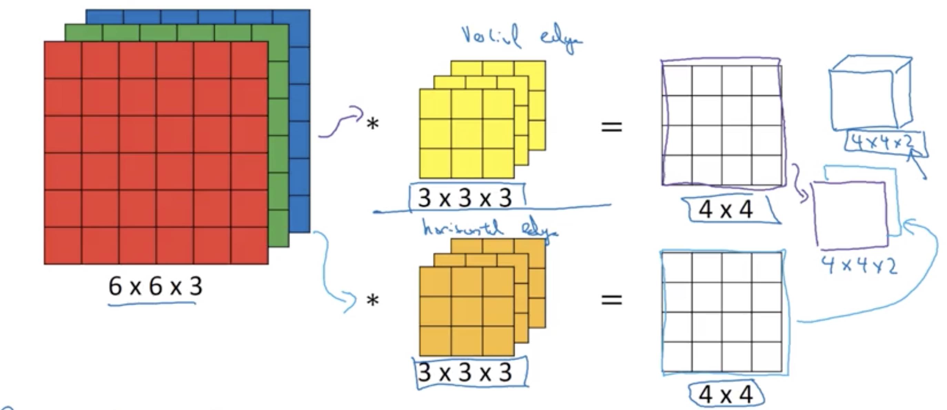
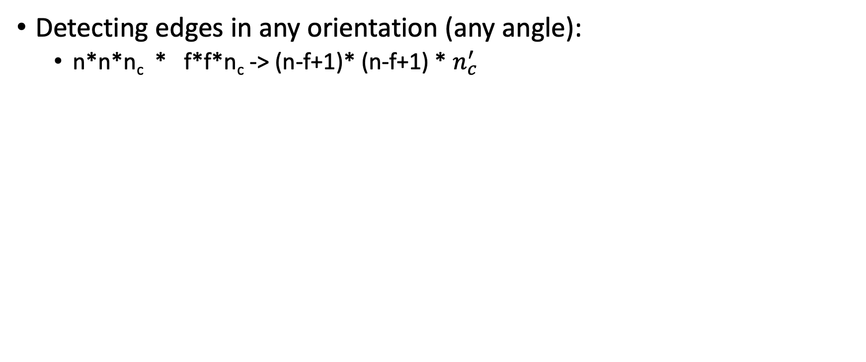
Convolutions over volumes
Detecting edges in any orientation (any angle):
n*n*n_{c} * f*f*n_{c} -> (n-f+1)* (n-f+1) * $n_{c}^{′}$

Slide 40
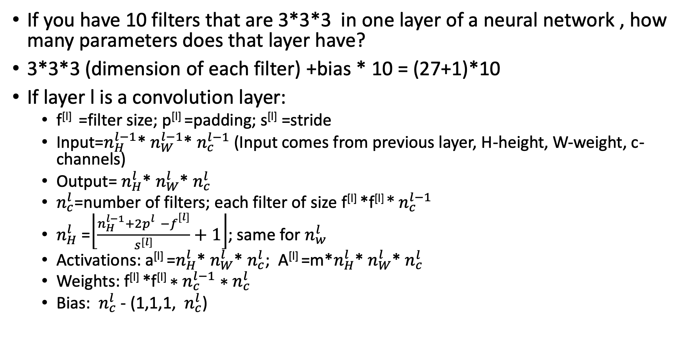
One layer of CNN
If you have 10 filters that are 3*3*3 in one layer of a neural network , how many parameters does that layer have?
3*3*3 (dimension of each filter) +bias * 10 = (27+1)*10
If layer l is a convolution layer:
f^{[l]} =filter size; p^{[l]} =padding; s^{[l]} =stride
Input=$n_{H}^{l−1}$* $n_{W}^{l−1}$* $n_{c}^{l−1}$ (Input comes from previous layer, H-height, W-weight, c-channels)
Output= $n_{H}^{l}$* $n_{W}^{l}$* $n_{c}^{l}$
$n_{c}^{l}$=number of filters; each filter of size f^{[l]} *f^{[l]} ${\text{∗ }n}_{c}^{l−1}$
$n_{H}^{l}$ =$\left\lfloor \frac{n_{H}^{l−1}+{2p}_{}^{l}−f_{}^{[l]}}{s^{[l]}}+1\right\rfloor$; same for $n_{w}^{l}$
Activations: a^{[l]} =$n_{H}^{l}$* $n_{W}^{l}$* $n_{c}^{l}$; A^{[l]} =m*$n_{H}^{l}$* $n_{W}^{l}$* $n_{c}^{l}$
Weights: f^{[l]} *f^{[l]} ${\text{∗ }n}_{c}^{l−1}$ ${\text{∗ }n}_{c}^{l}$
Bias: ${ n}_{c}^{l}$ - (1,1,1, ${ n}_{c}^{l}$)

Slide 41
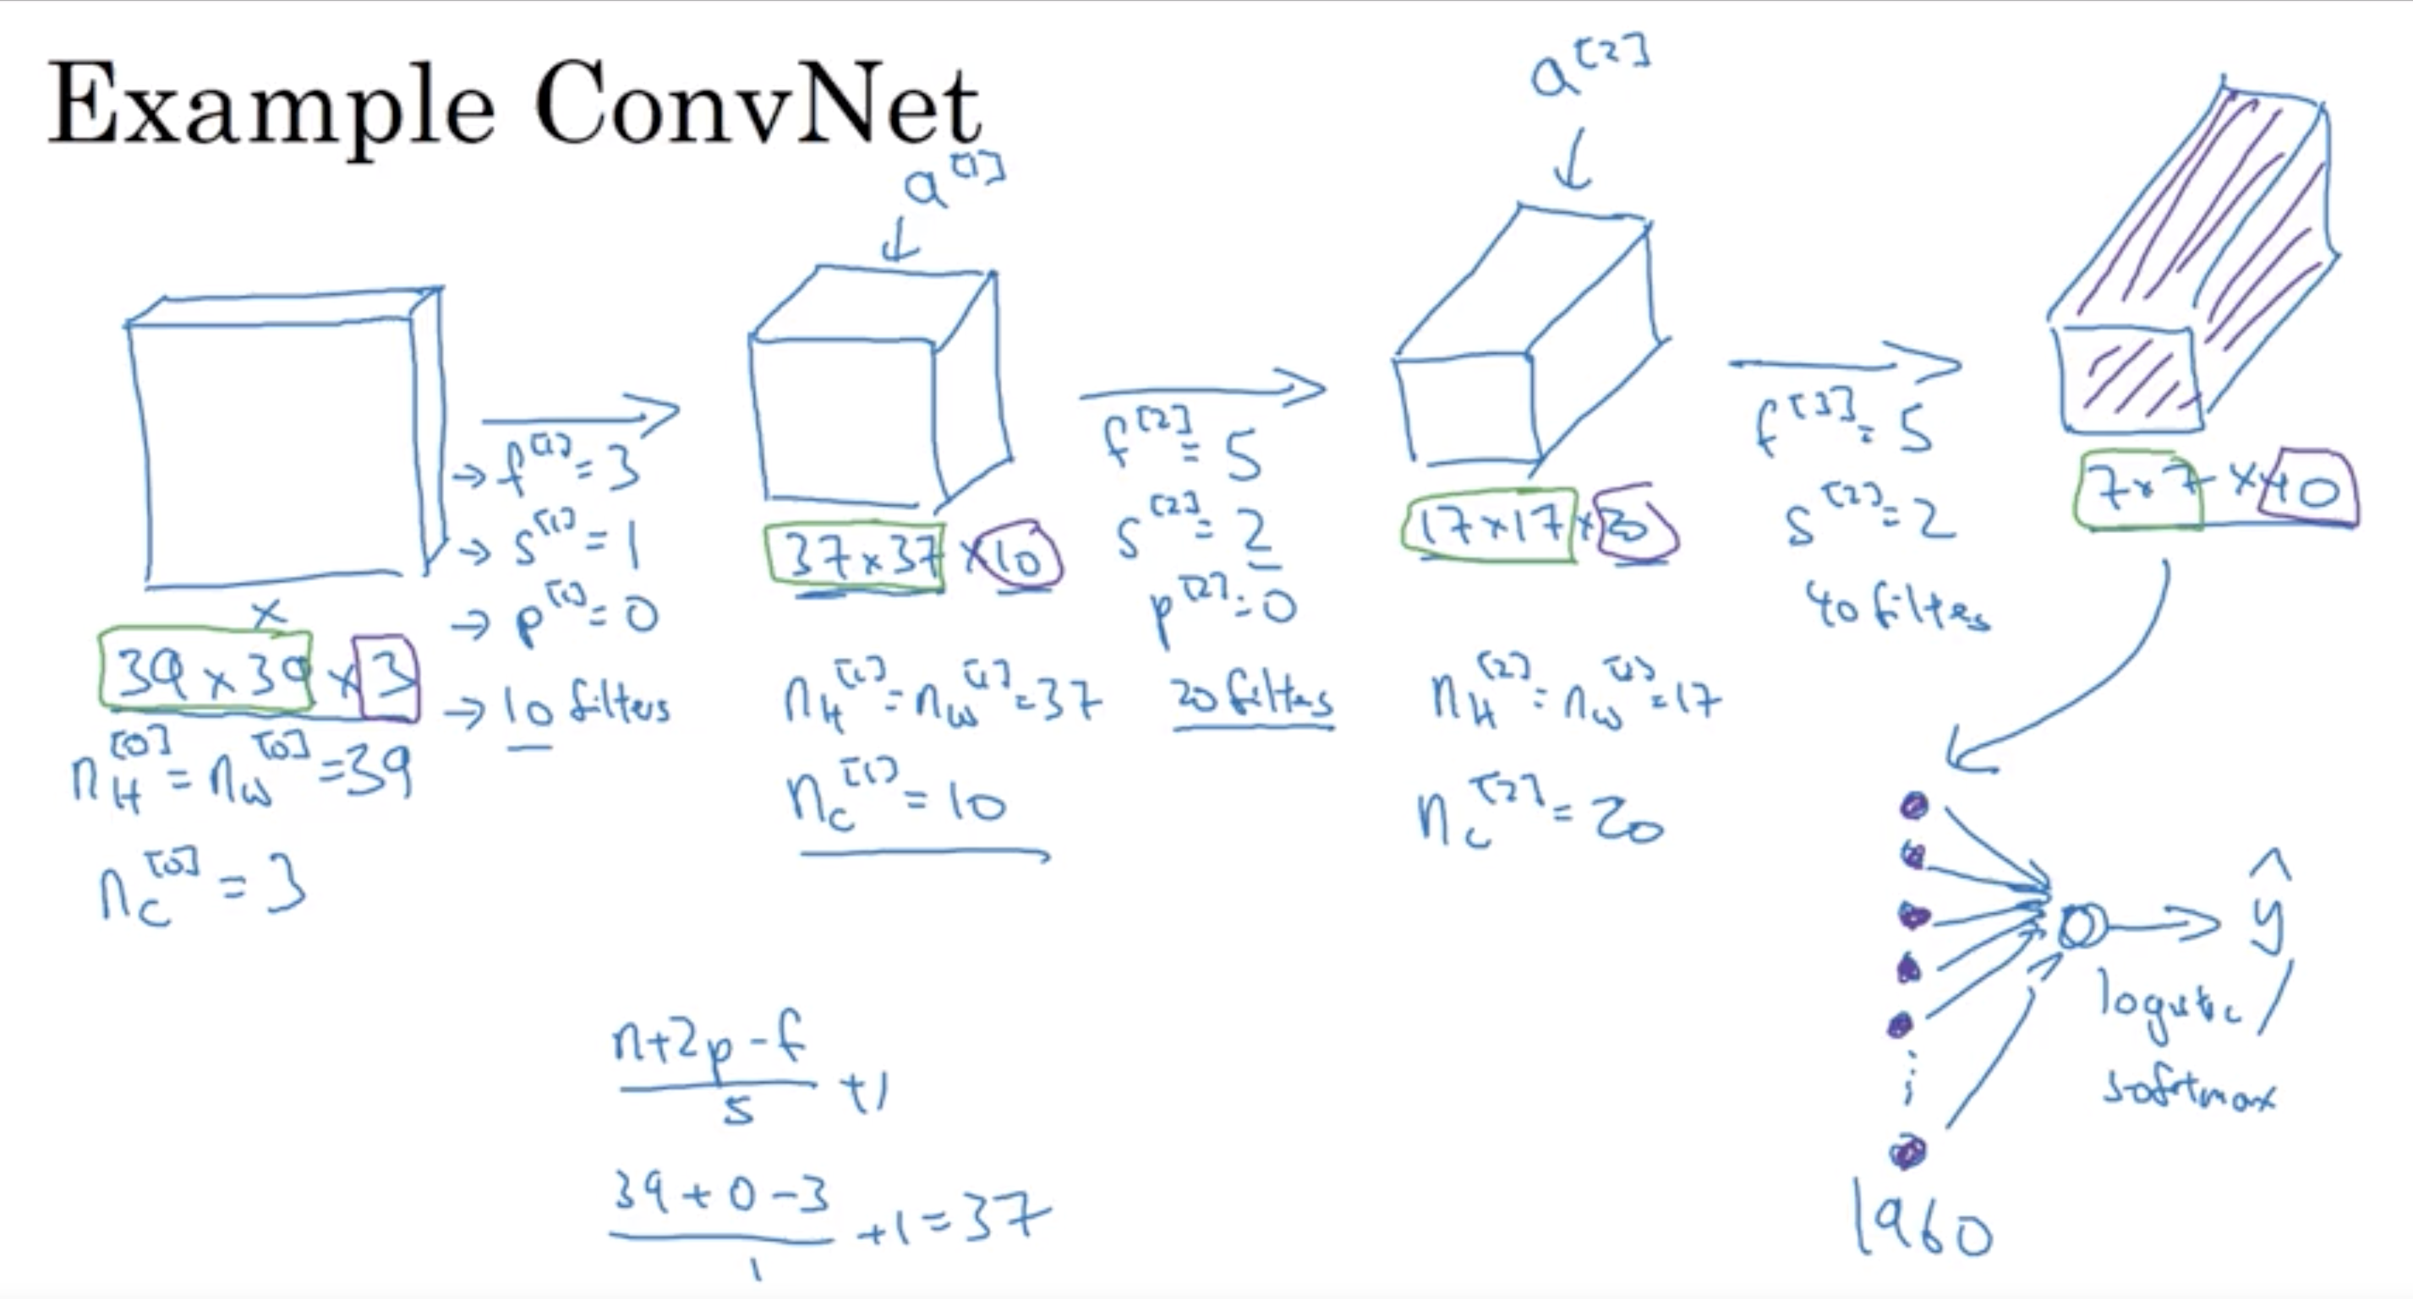

Slide 42
Types of layers in Convolutional network
Convolution (CONV)
Pooling (POOL)
Fully Connected (FC)

Slide 43
Pooling Layers: Max Pooling
No parameters to learn like weights
Hyperparameters
f: filter size
s: stride
Max or average pooling
P: padding (very rarely used in max pooling)

Slide 44


Pooling Layers: Max Pooling

Slide 45

Pooling Layers: Average Pooling

Slide 46

Neural Network Example: LeNet-5
A layer is counted when parameters can be learnt like weights. So, we call CONV+POOL as a single layer because POOL has no weights to learn

Slide 47

Neural Network Example: LeNet-5

Slide 48

Why Convolutions
Parameter sharing: A feature detector (such as a vertical edge detector) that’s useful in one part of the image is probably useful in another part of the image
sparsity of connections: In each layer, each output value depends only on a small number of inputs
Good at capturing translation invariance: a image of cat shifted to right is still a cat

Slide 49


Quiz

Slide 50
Programming Assignment Notes
The main benefits of padding are the following:
It allows you to use a CONV layer without necessarily shrinking the height and width of the volumes. This is important for building deeper networks, since otherwise the height/width would shrink as you go to deeper layers. An important special case is the "same" convolution, in which the height/width is exactly preserved after one layer.
It helps us keep more of the information at the border of an image. Without padding, very few values at the next layer would be affected by pixels as the edges of an image.

Slide 51

LeNet-5
Graph Transformer Network for reading bank check
Replacing hand-crafted feature with automated ML
Pattern recognition systems combines automated learning+ hand crafted algorithms
Feature extractor- hand crafted mostly, classifier- ML trained

Slide 52

AlexNet

Slide 53
Next Week
Implementation of CNNS
Read papers for CNN architecture
Start with data preprocessing

Slide 54
References:
Adam paper: https://arxiv.org/pdf/1412.6980.pdf
Pooling: http://deeplearning.stanford.edu/tutorial/supervised/Pooling/

